Slide 1
TrendCare v3.6 to v3.6.1 Upgrade Guide

Slide 2
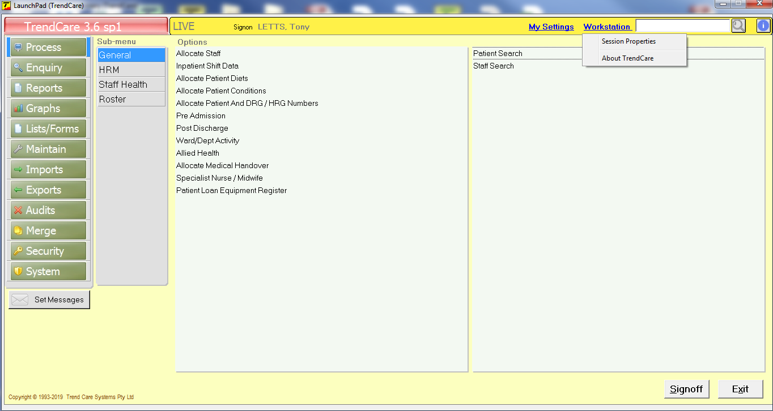
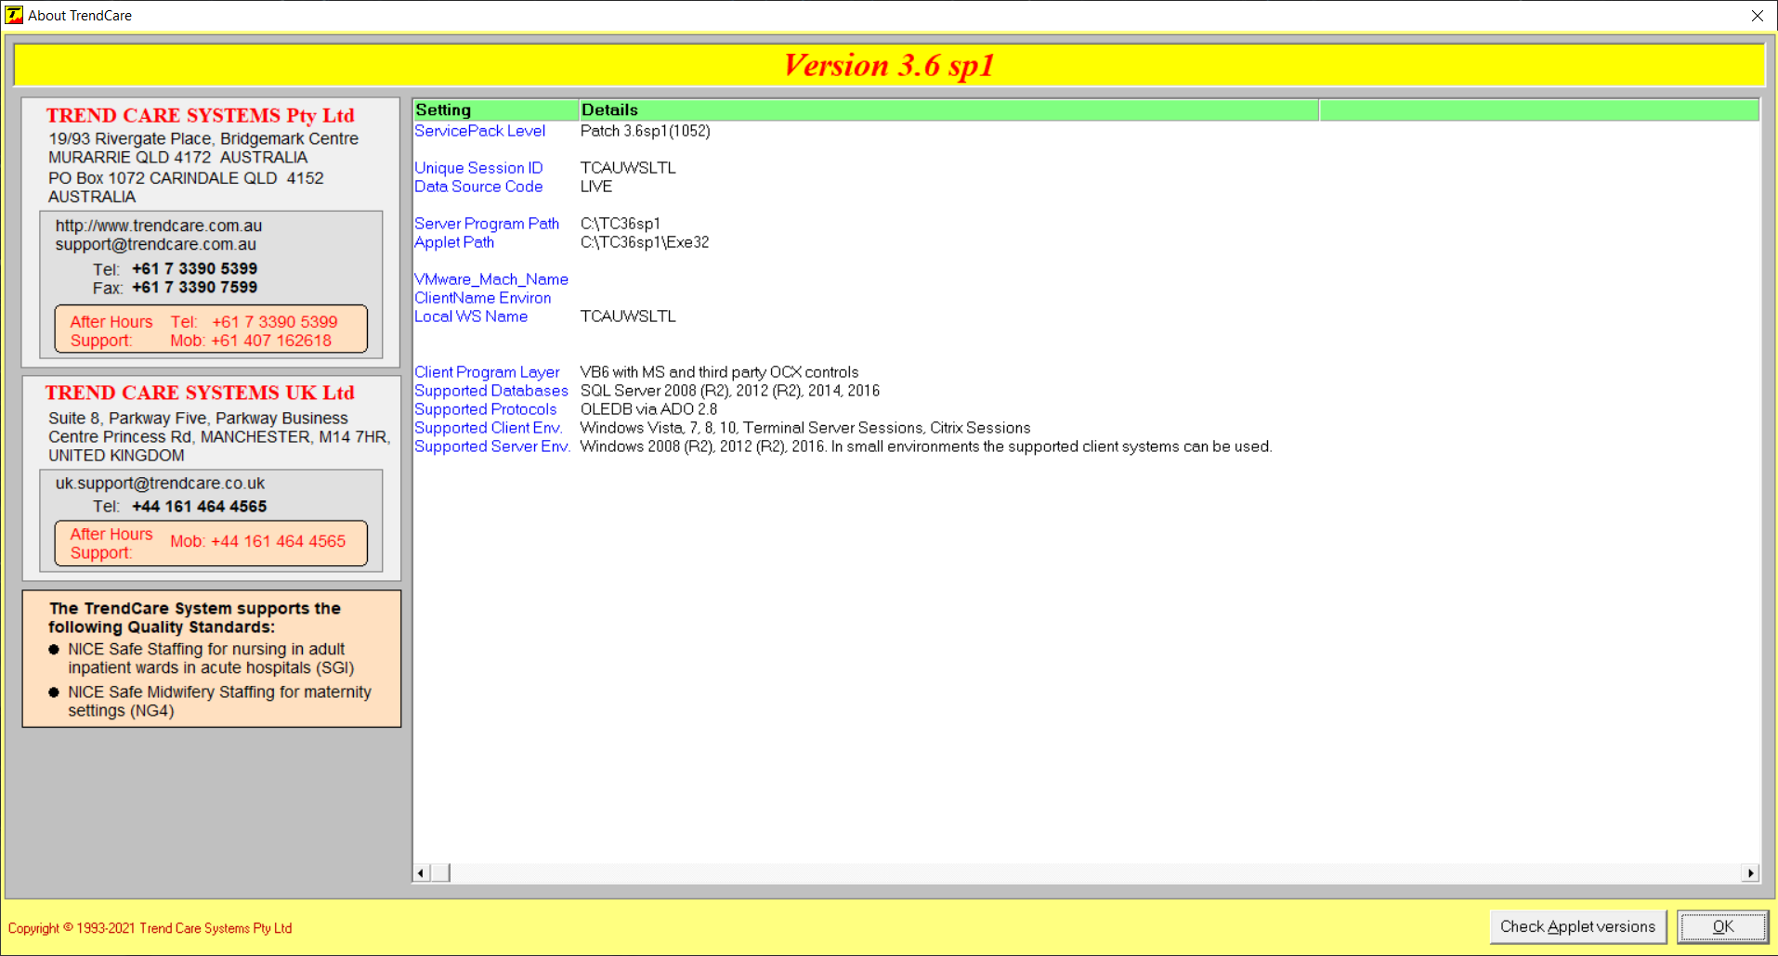
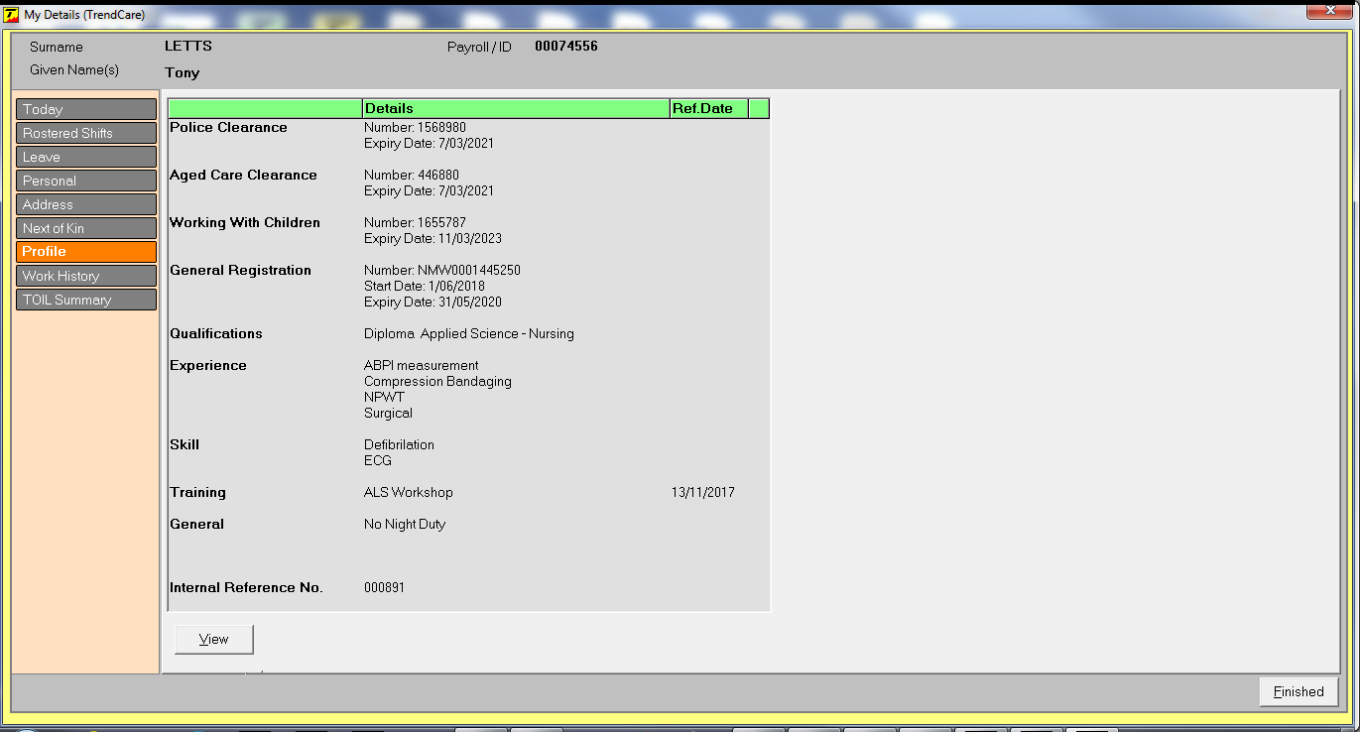
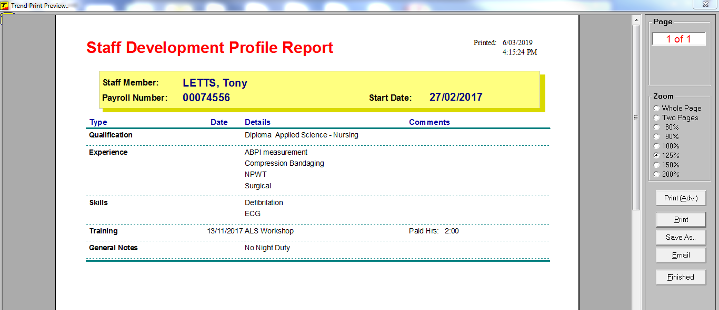
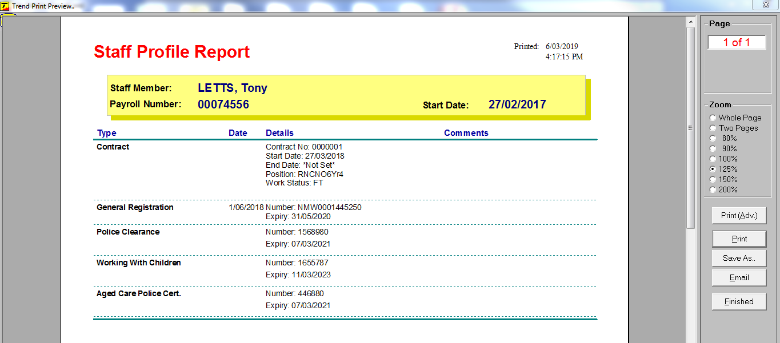
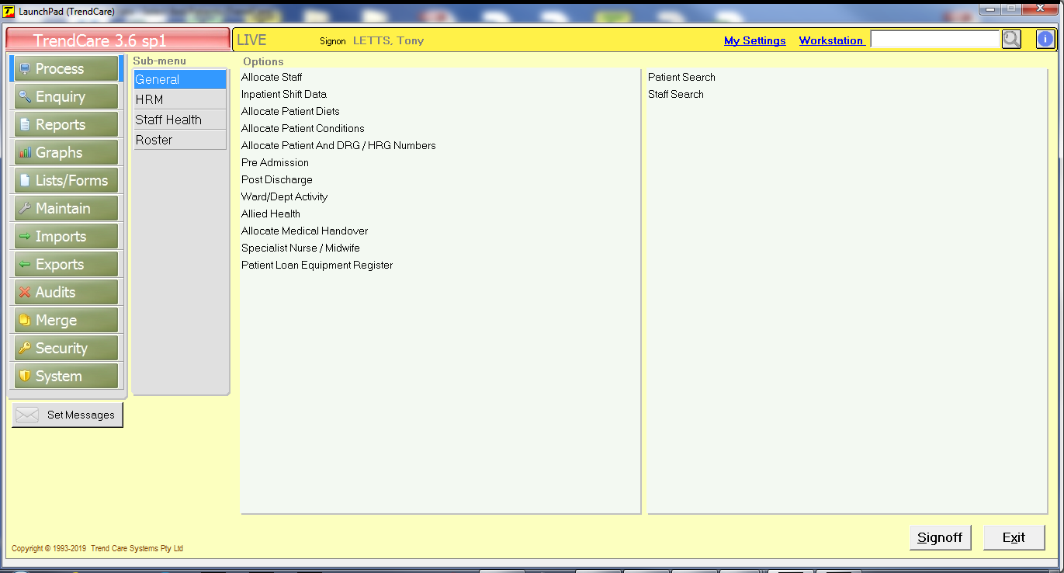
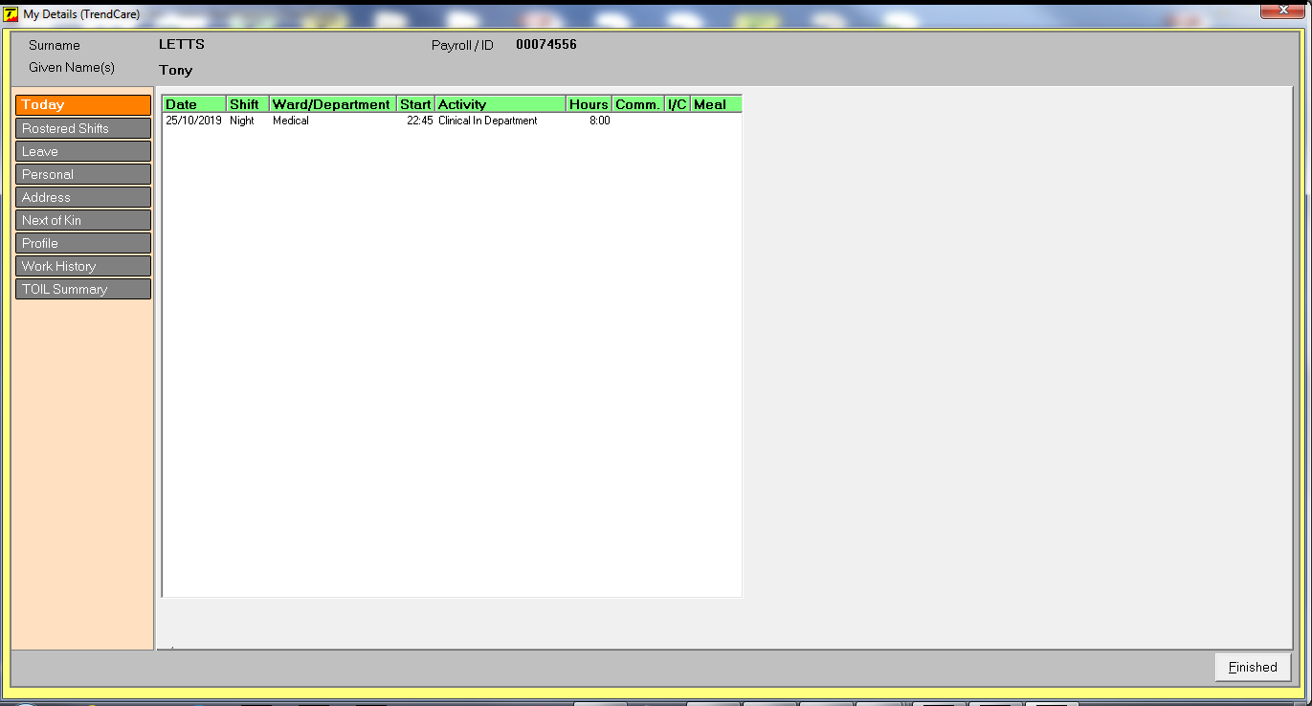
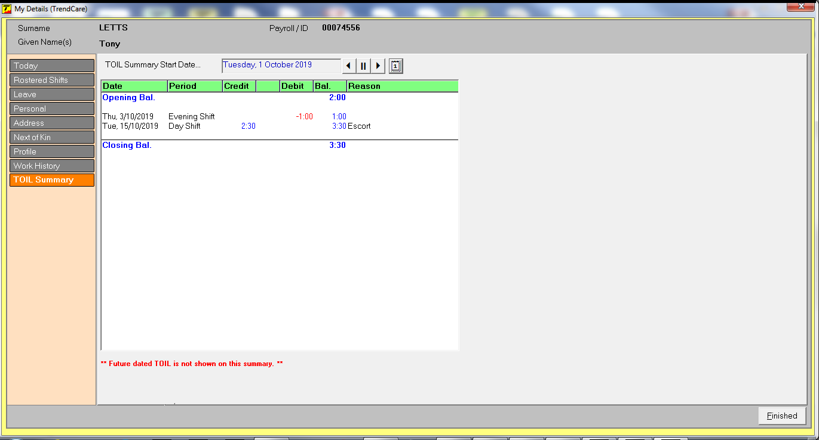
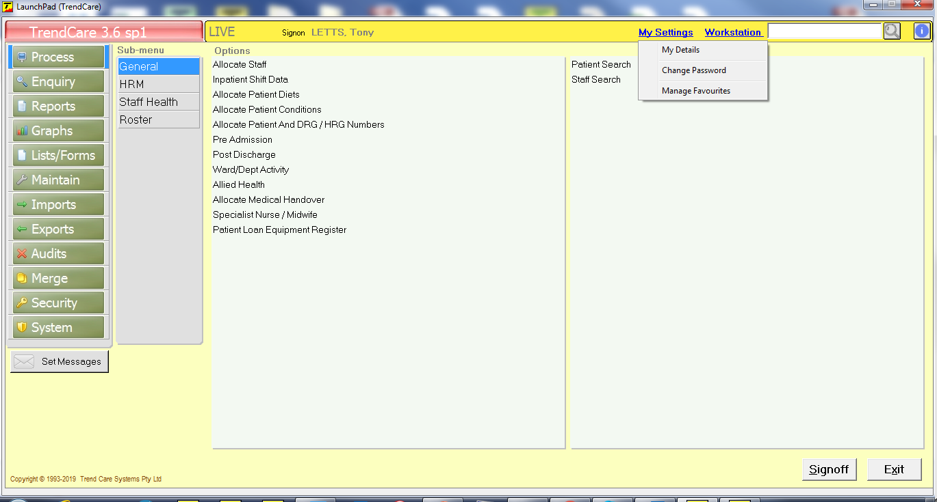
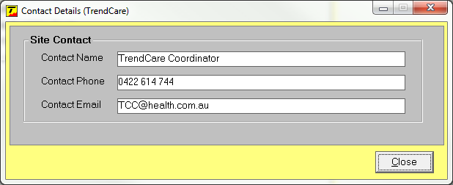
LaunchPad
About TrendCare screen has been updated and includes a reference to UK NICE standards found in Workstation
A TOIL Summary tab has been added to My Details found in My Settings
Information Icon now only shows site specific contact details- TrendCare Systems contact details removed
A user’s Development Profile and Profile can now be printed using the Profile tab
Notes:
Allocate Staff Screen
Total Hours column has been split, now shows as:
Work Hours and Absent Hours

Slide 3
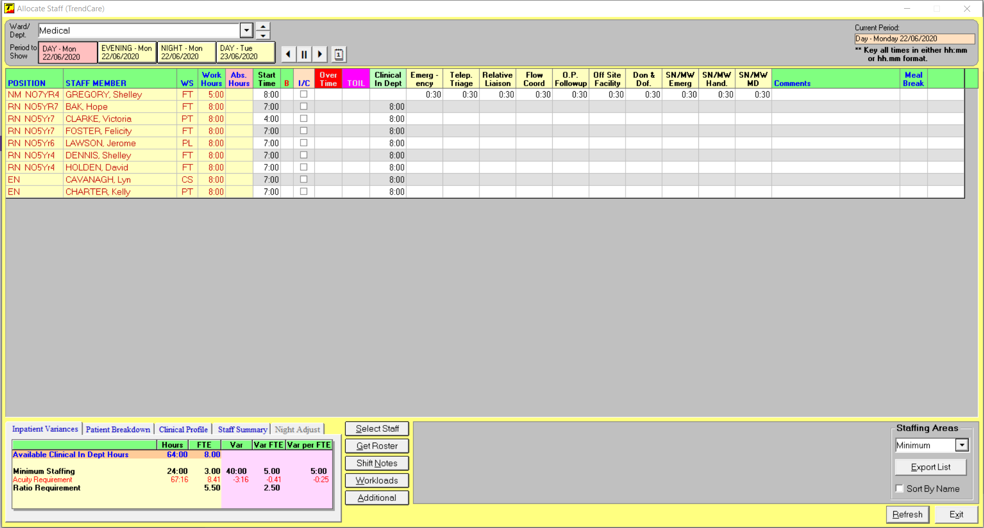
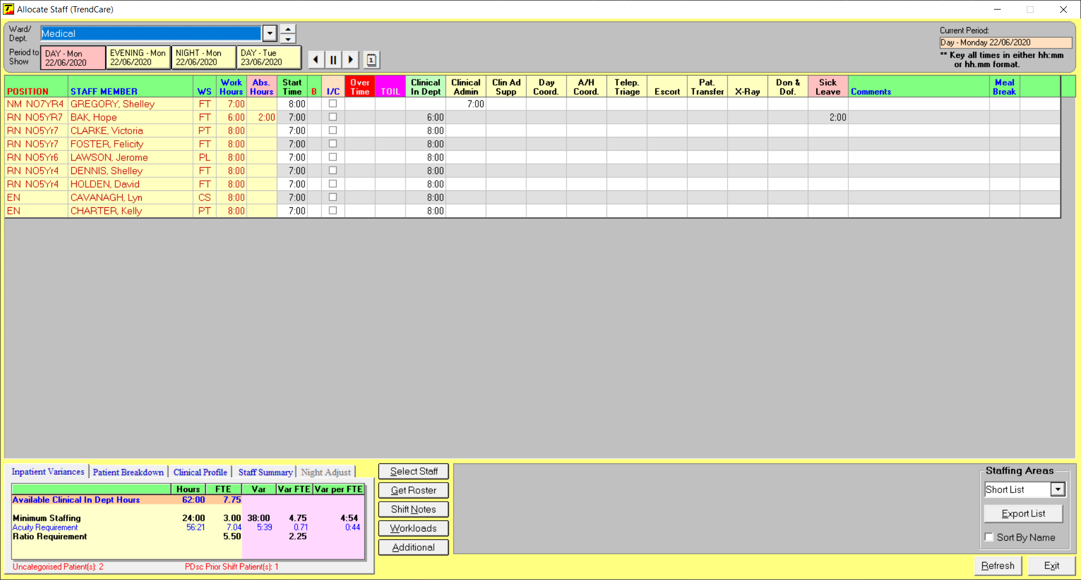
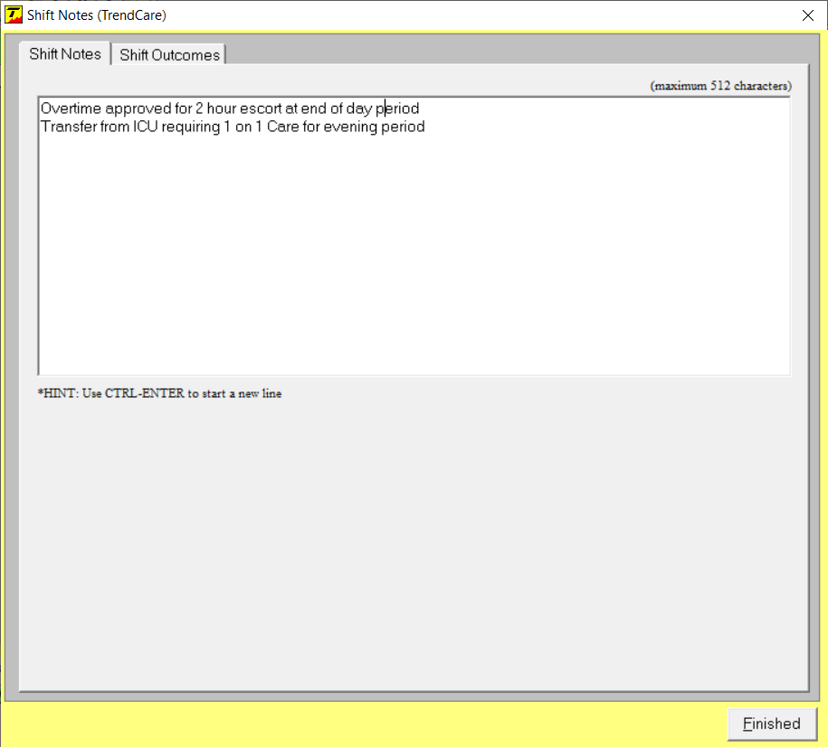
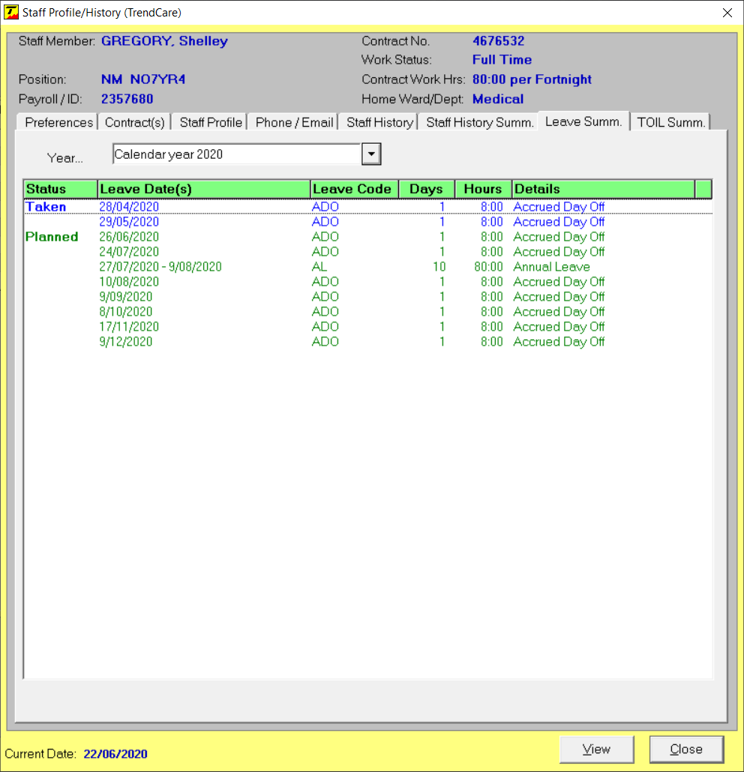
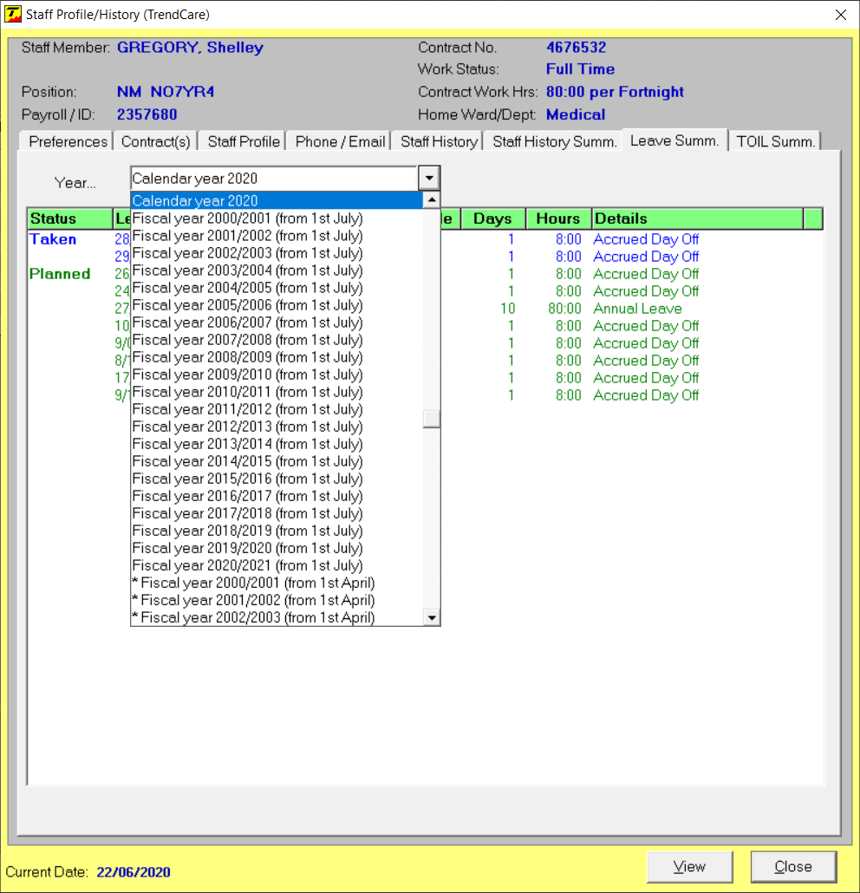
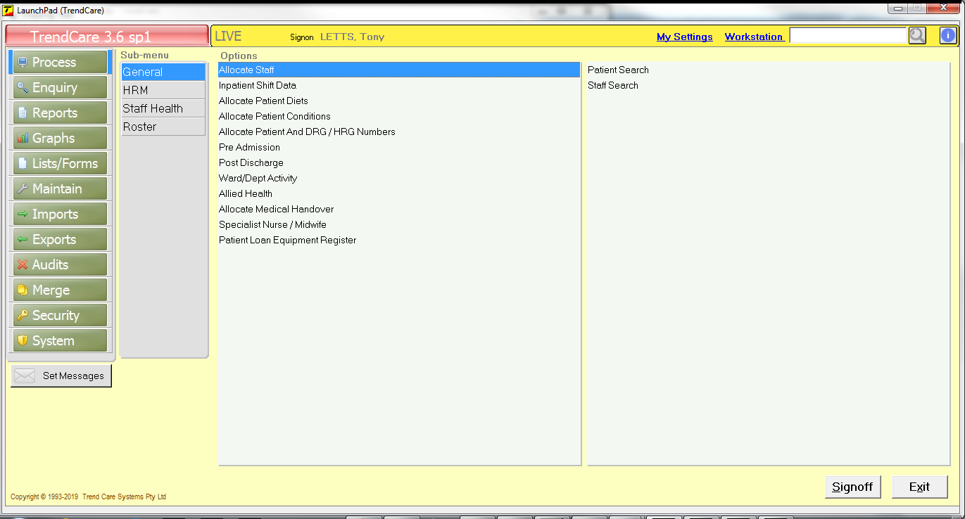
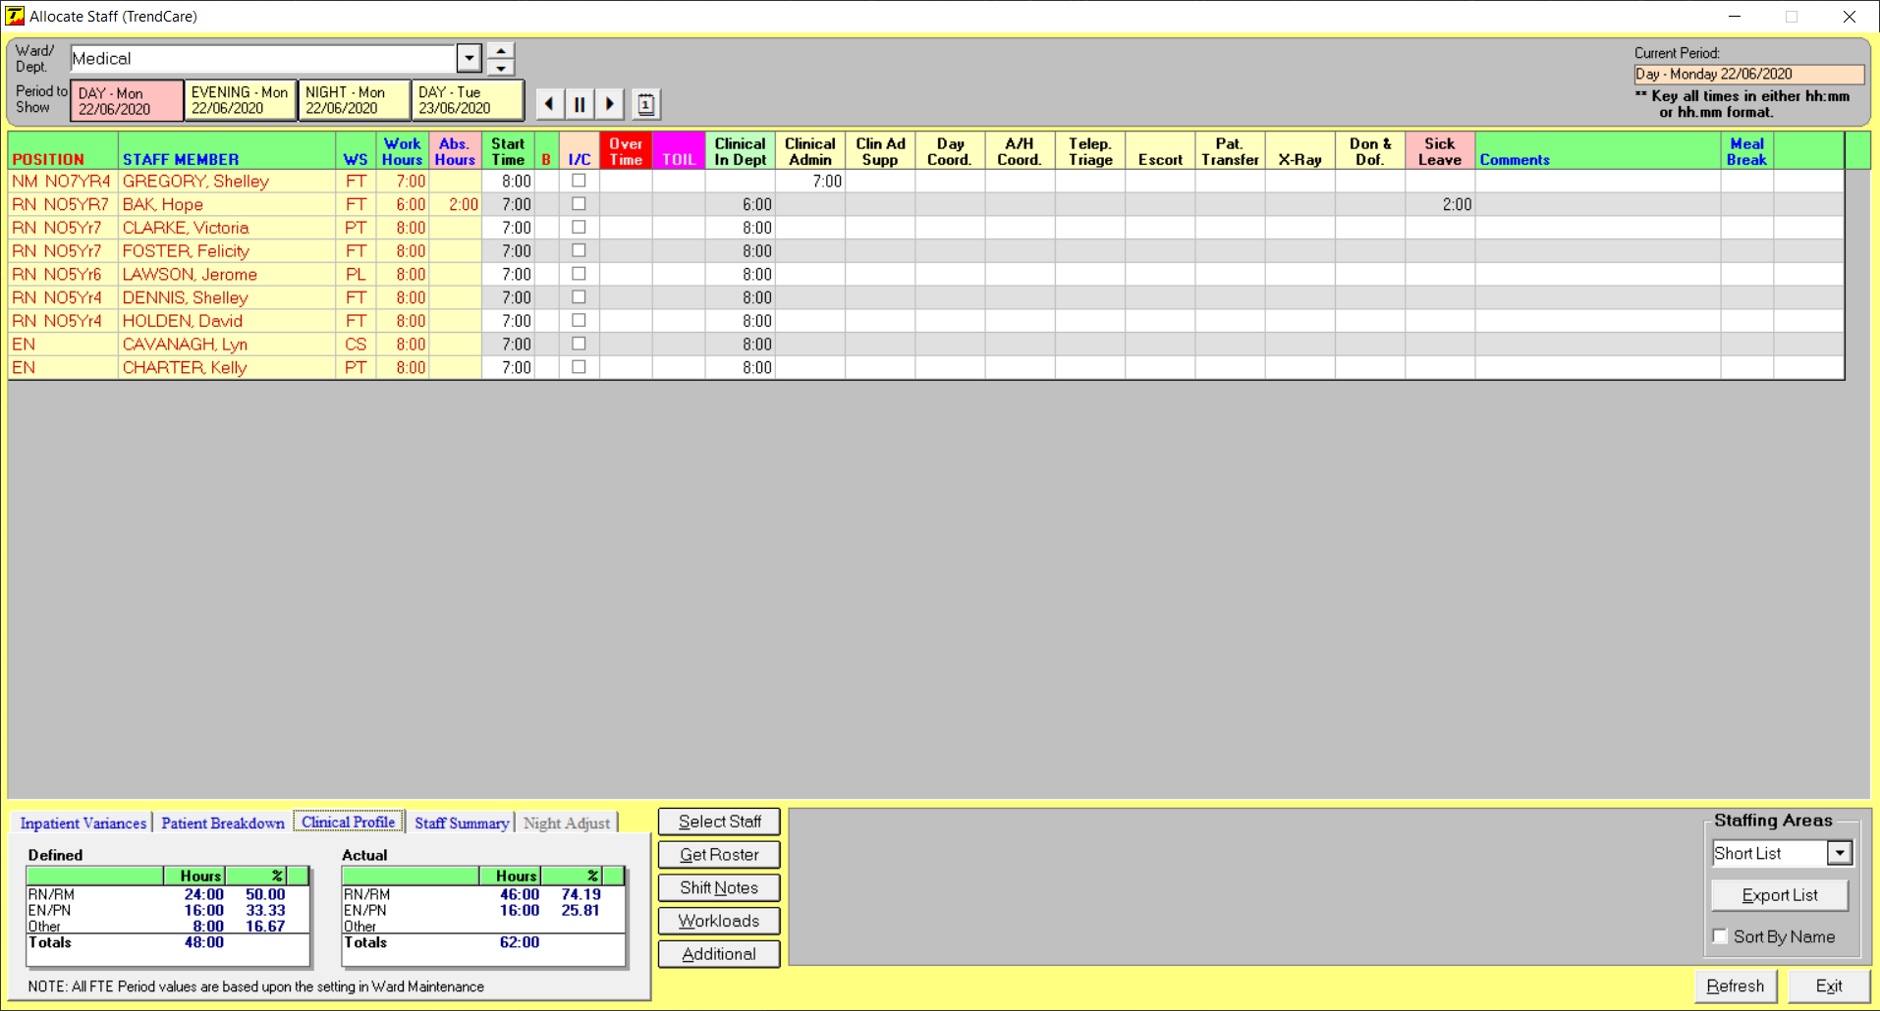
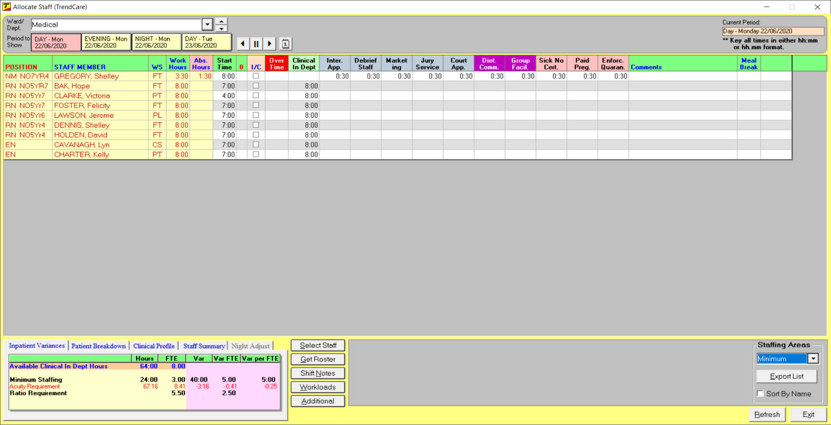
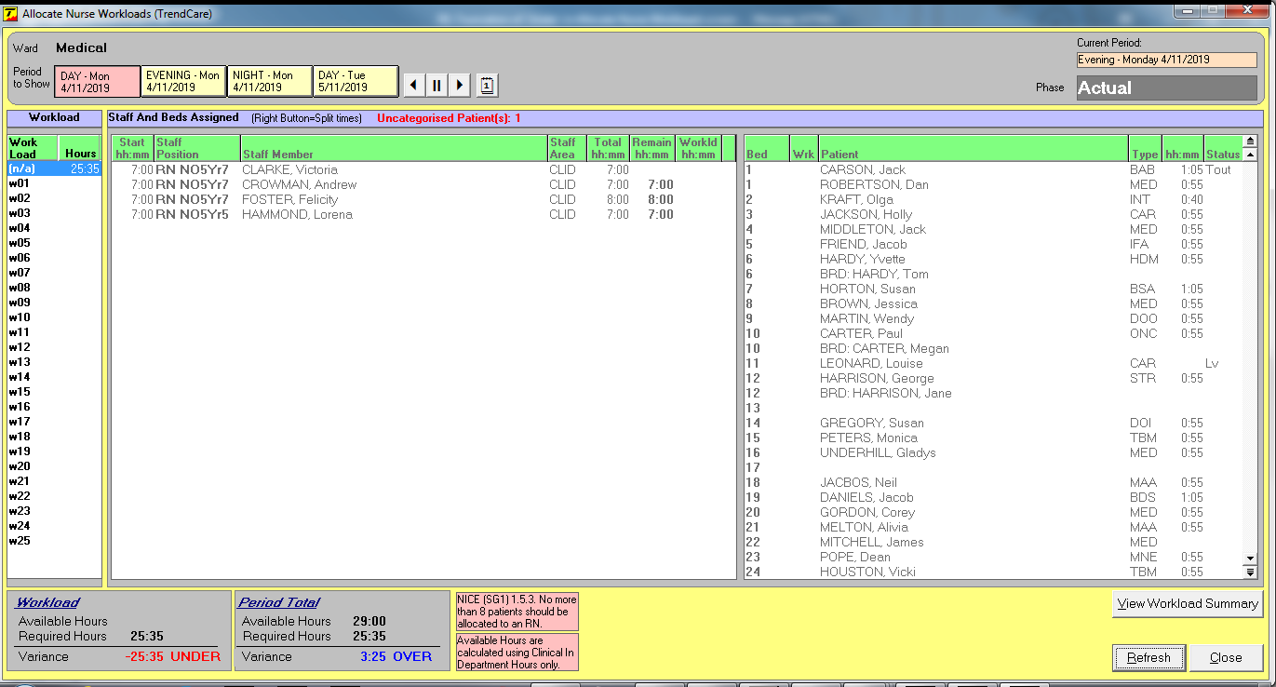
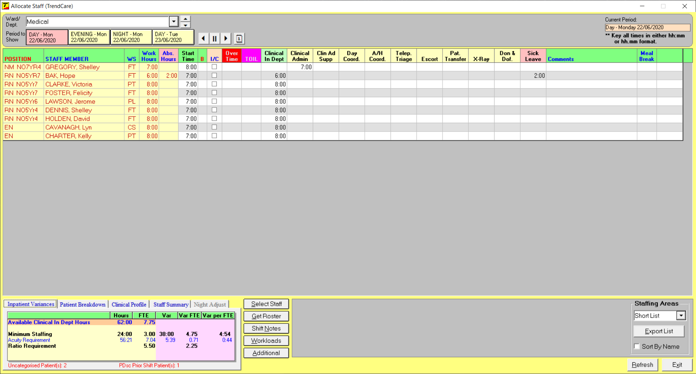
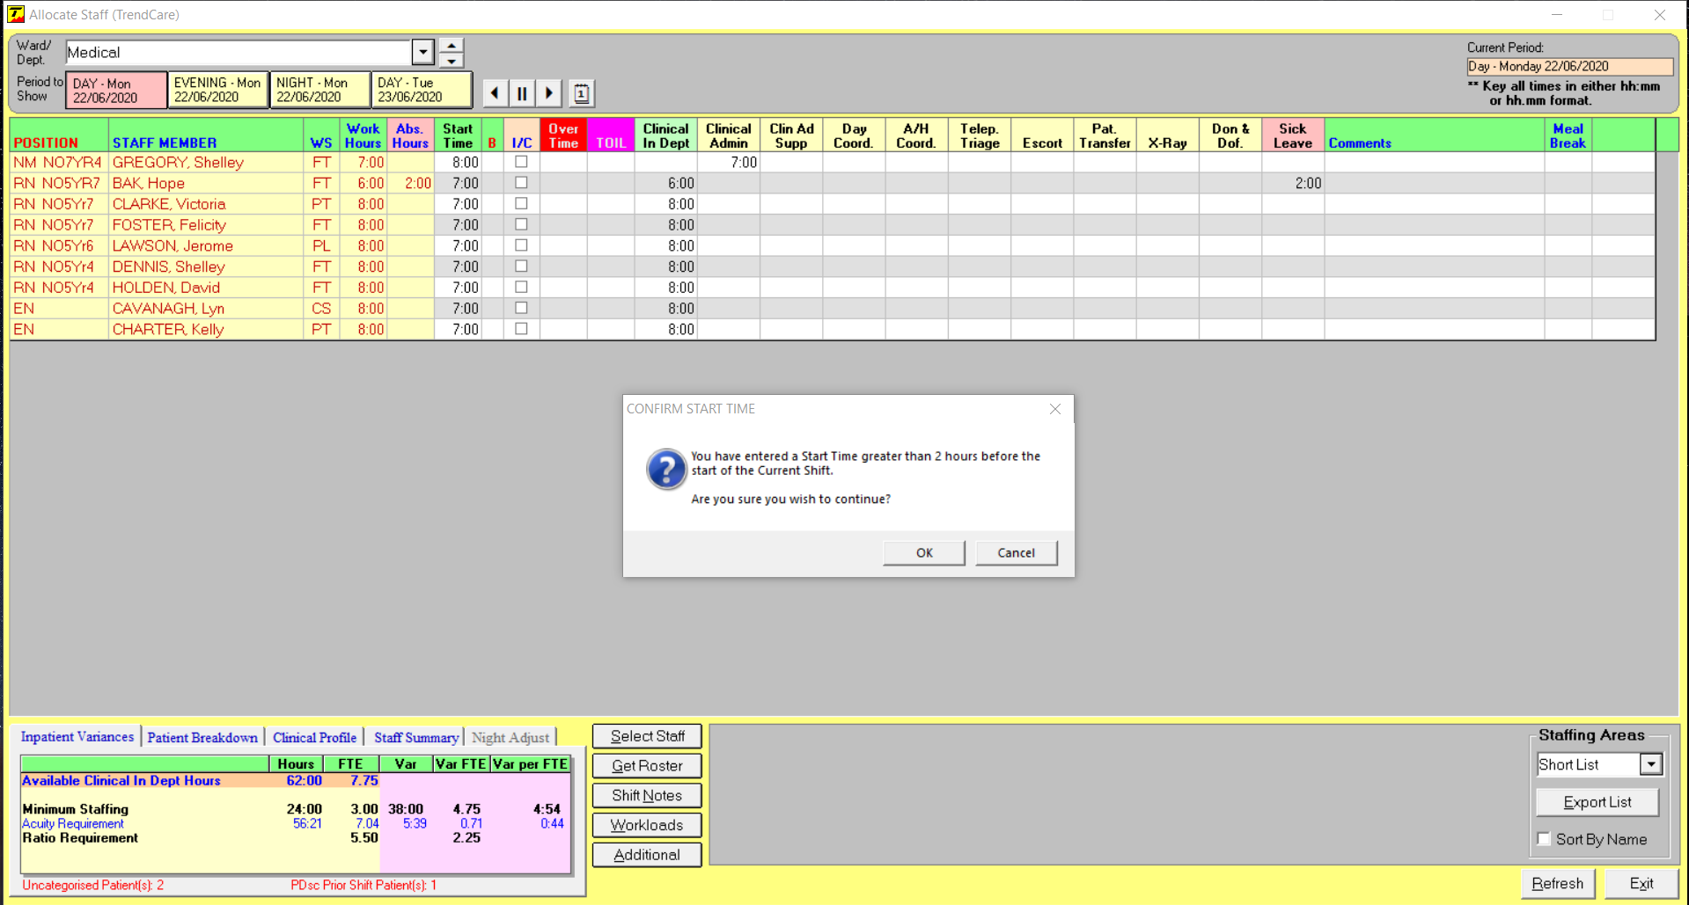
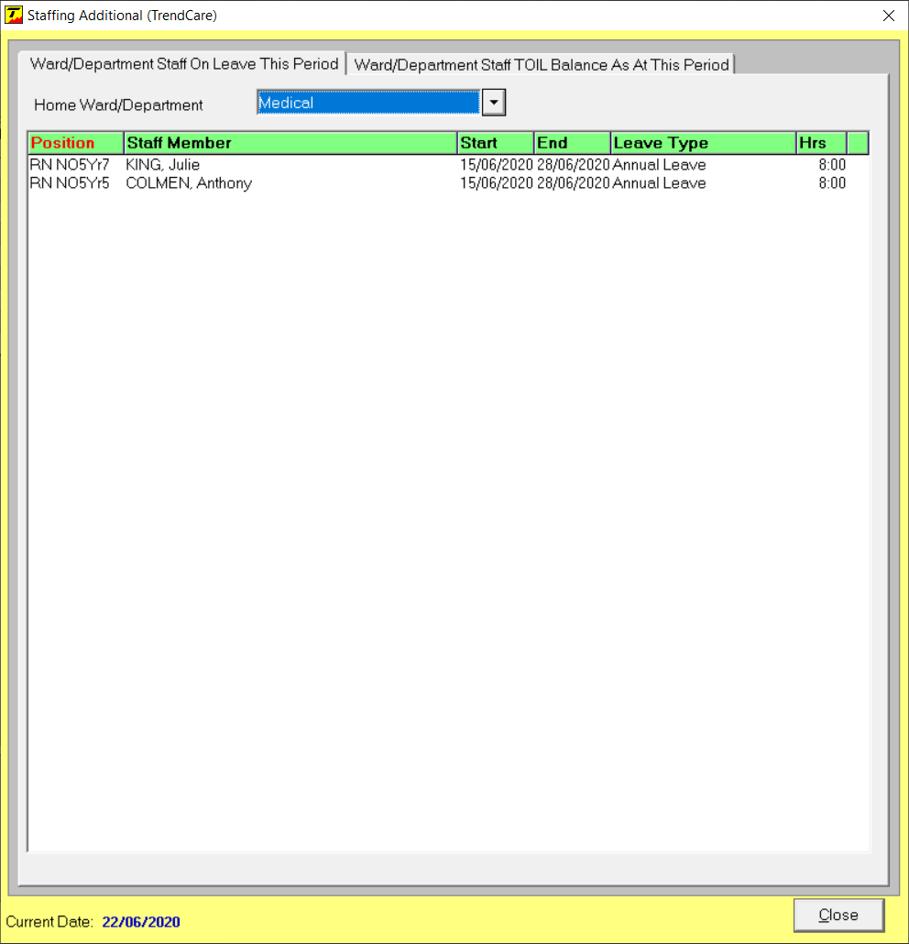
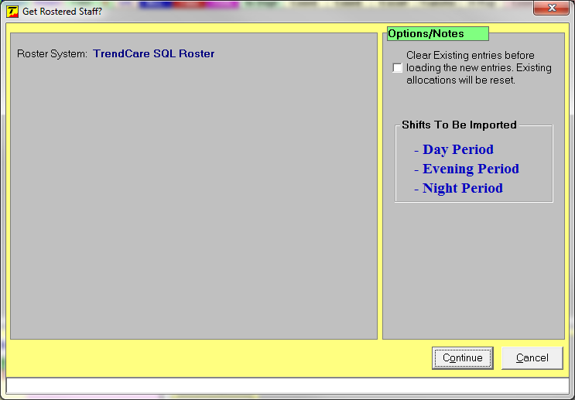
Process General - Allocate Staff
20 New Staffing Areas have been added:
10 Clinical
5 Non-clinical
3 Absenteeism
2 Allied Health
R) Click Staffing Area to see definition
References to ‘Shift’ have changed to: Period
This also includes references in ‘Get Roster’
References to ‘Shift’ have changed to: Period
A counter has been added to show the number of patients who have a Predicted Discharge (PDsc) for a prior shift
Allocate Workload screen references to ‘Shift’ have changed to: Period
Absent Hours column has been added
When R) Clicking a staff members name to display Staff Notes/Profile the year selection field now includes option to display by Fiscal Year
When a start time for a staff member is set to be more than 2 hours before the period start time or after the end time of the period a confirmation warning will pop-up
Leave is now shown with corresponding Hours– this can be seen when clicking Additional
Shift Notes field has been increased to 512 characters
Within the Clinical Profile Tab, RN has been changed to RN/RM
NICE recommendation (SG1) has been added to Allocate Workload in both the Process and Enquiry screens
This only shows when the country/state, in System Properties, is set to: United Kingdom
Notes:
Allocate Staff Screen
Total Hours column has been split, now shows as:
Work Hours and Absent Hours

Slide 4
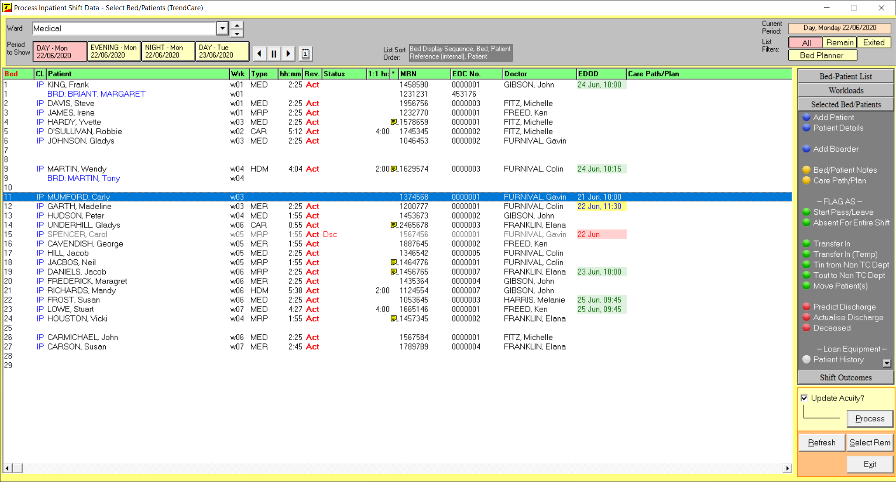
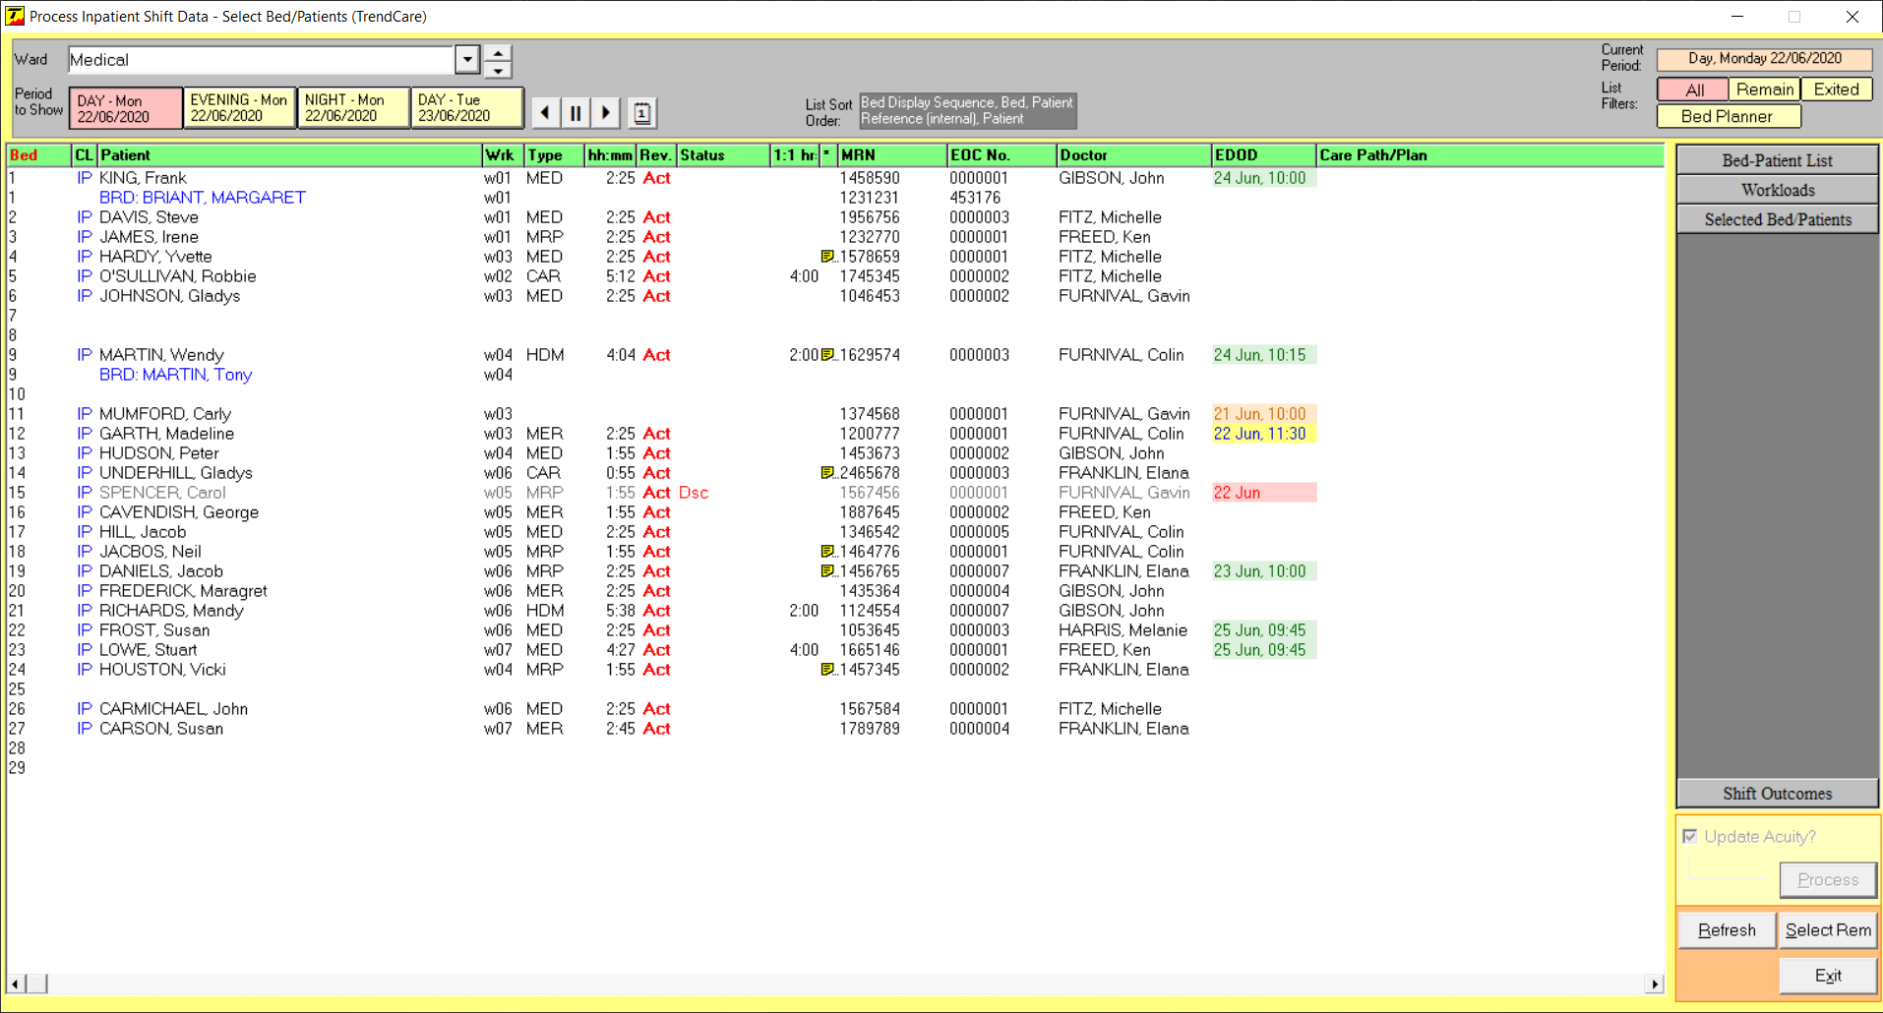
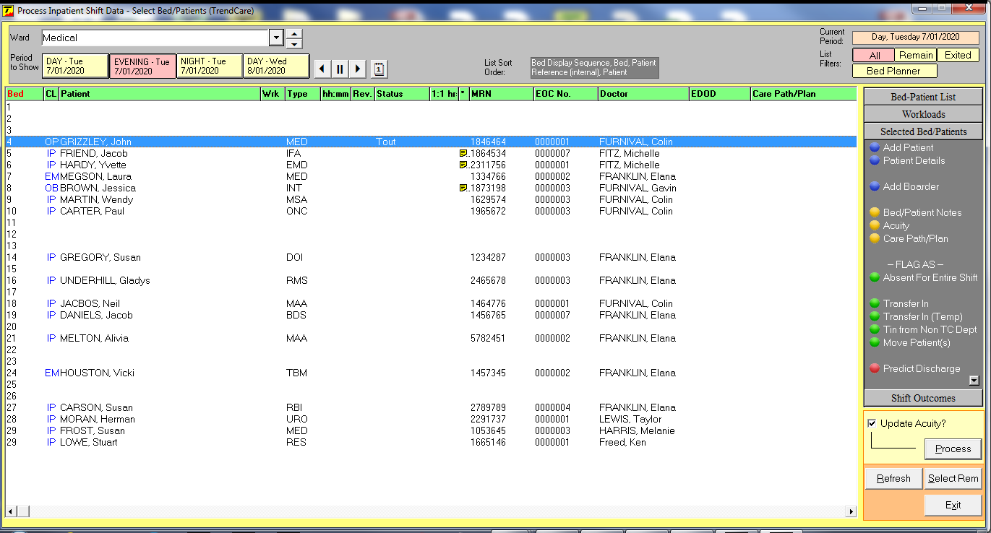
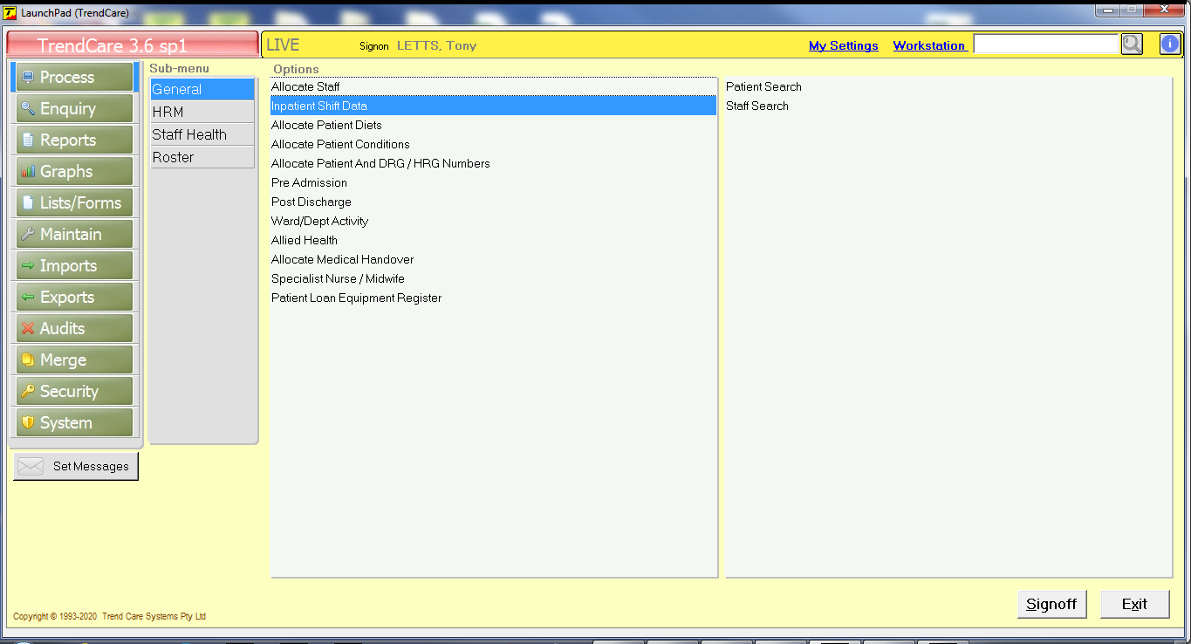
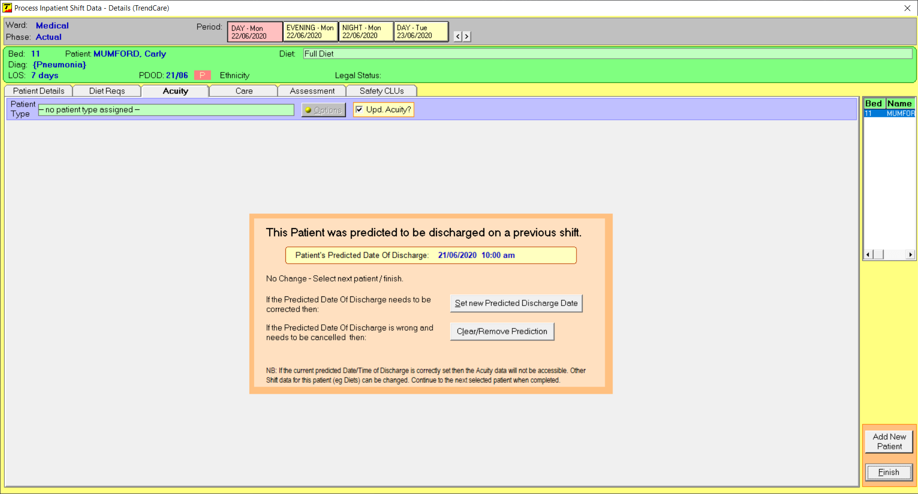
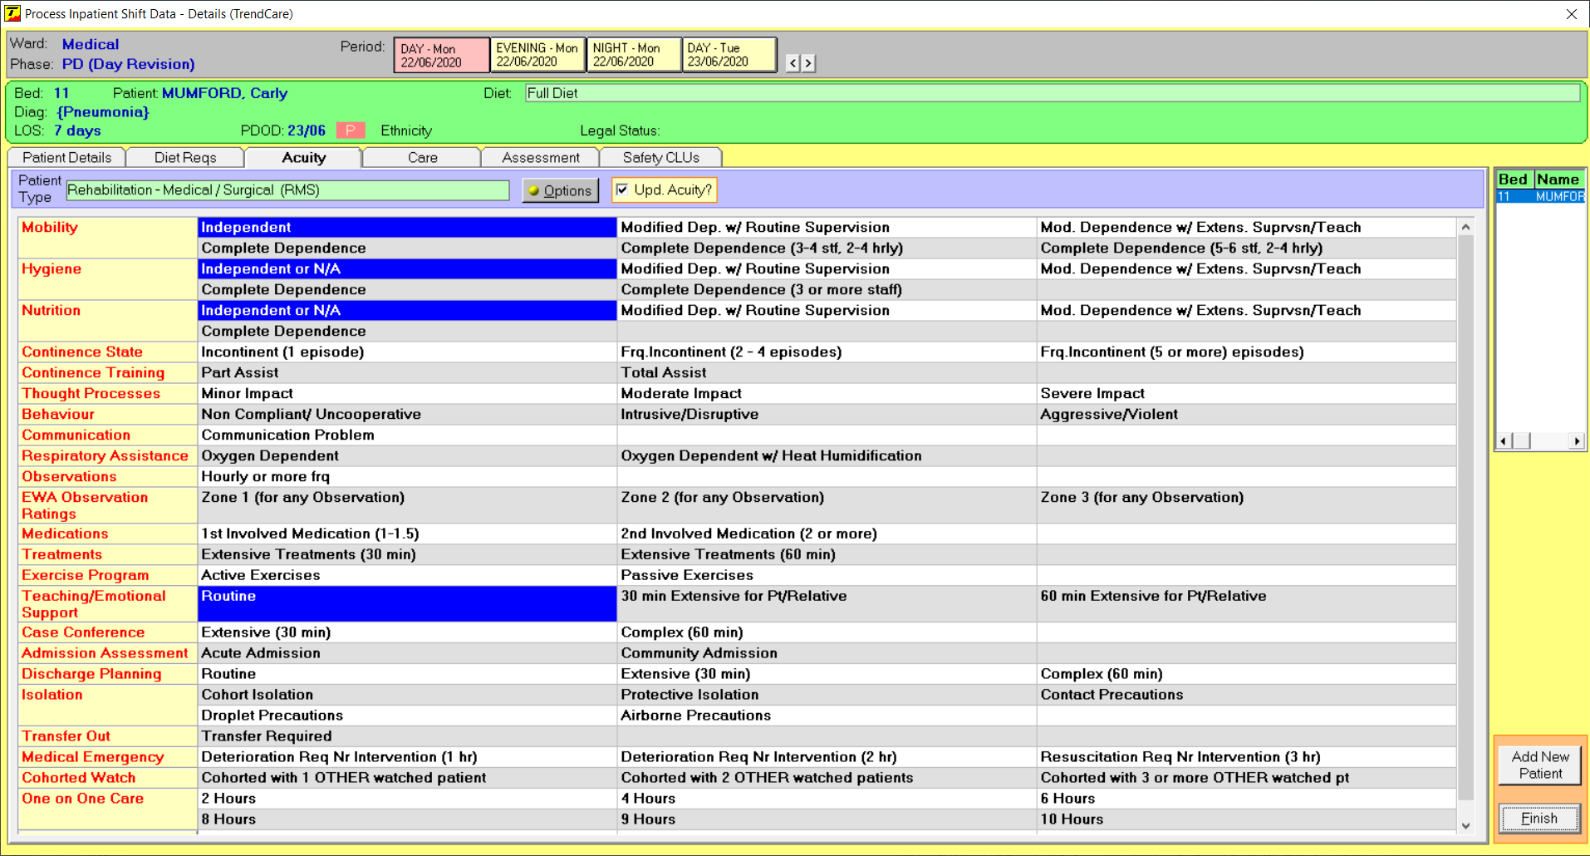
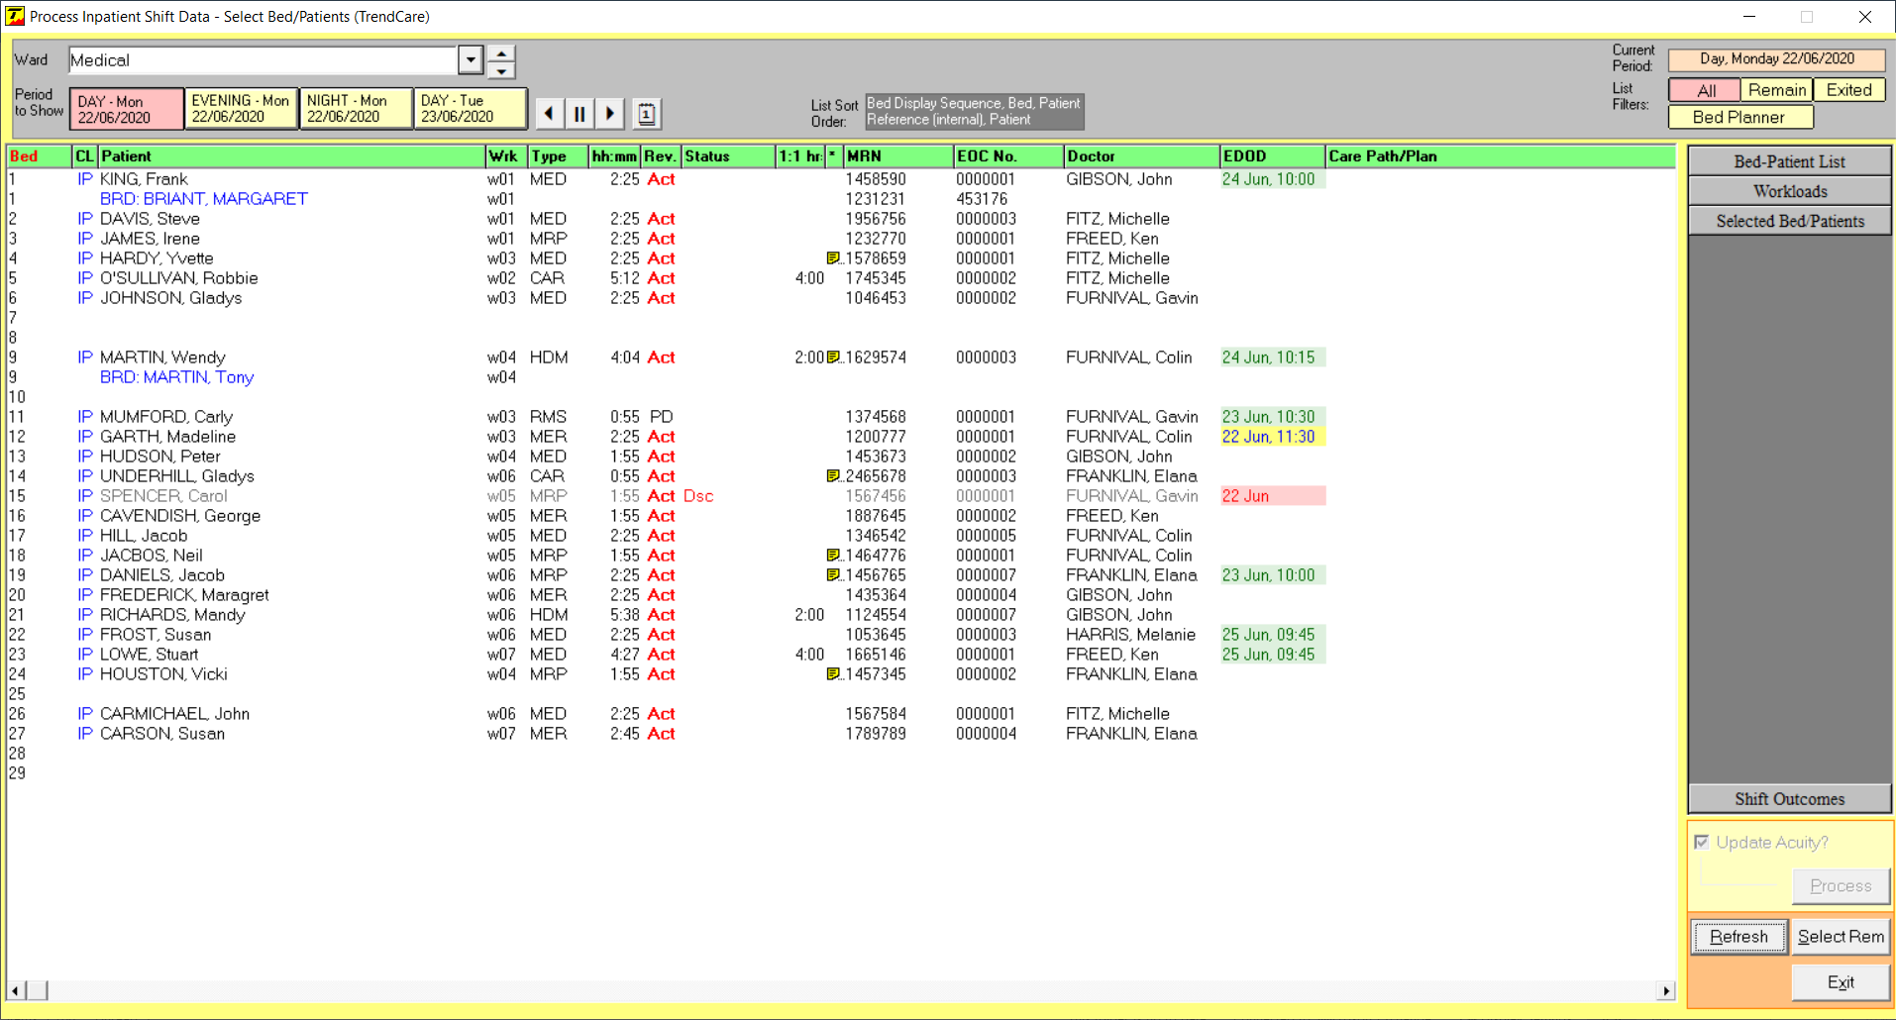
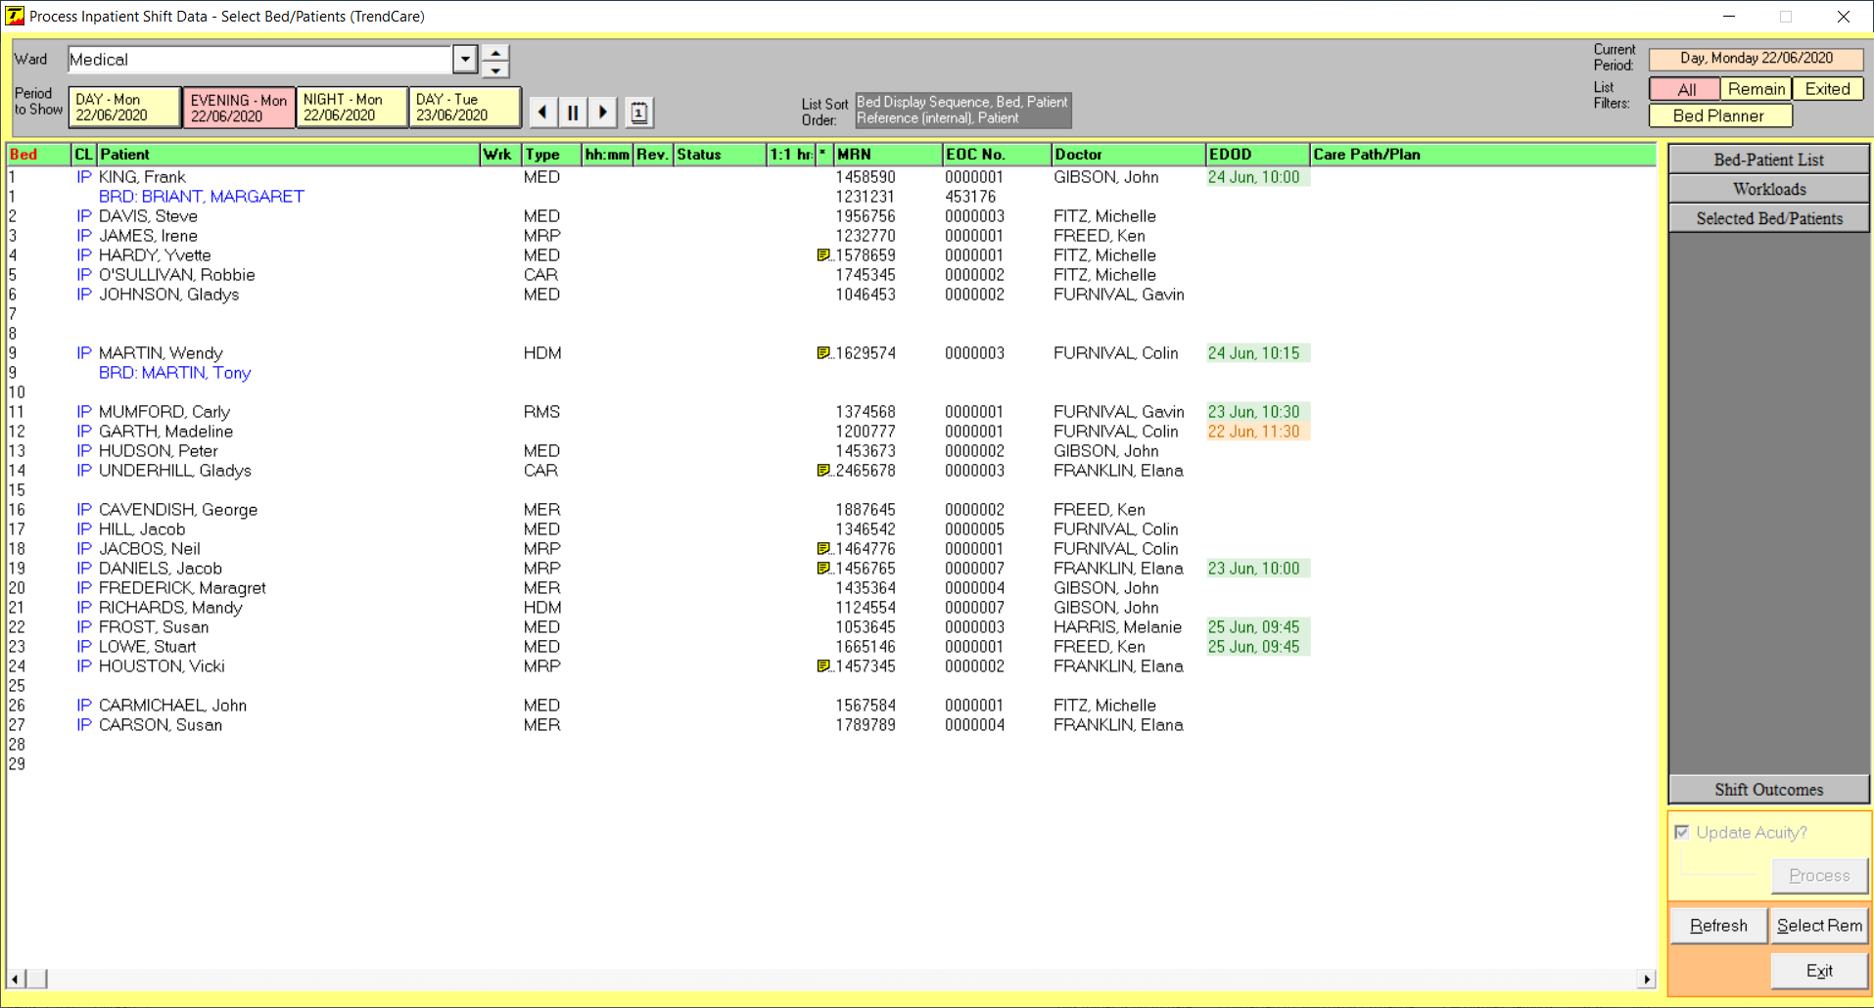
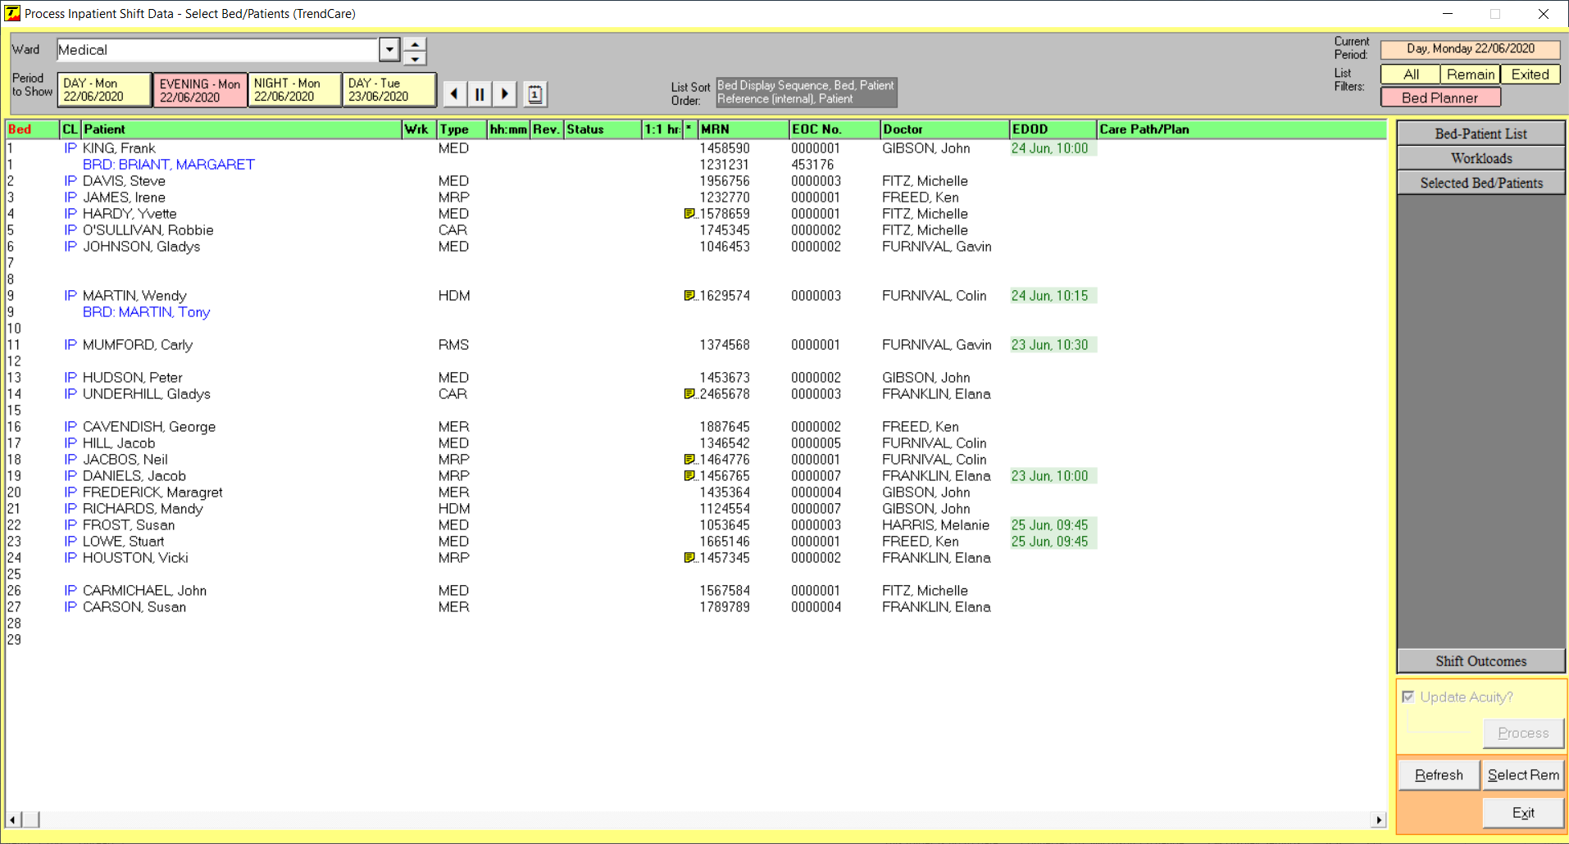
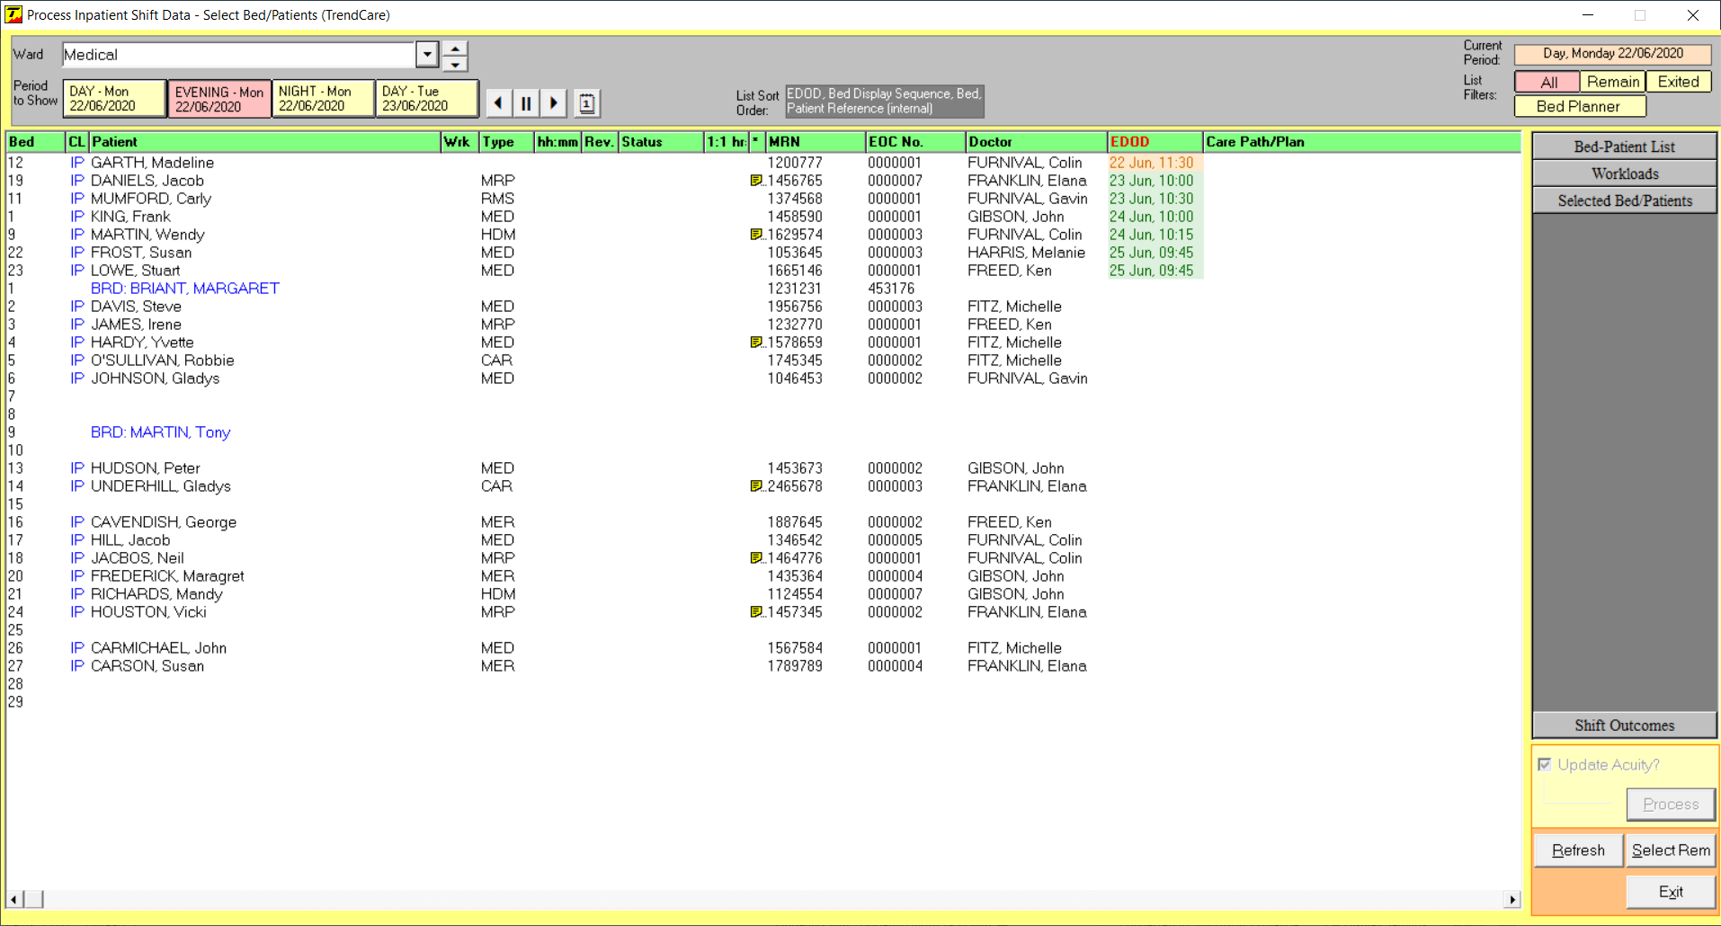
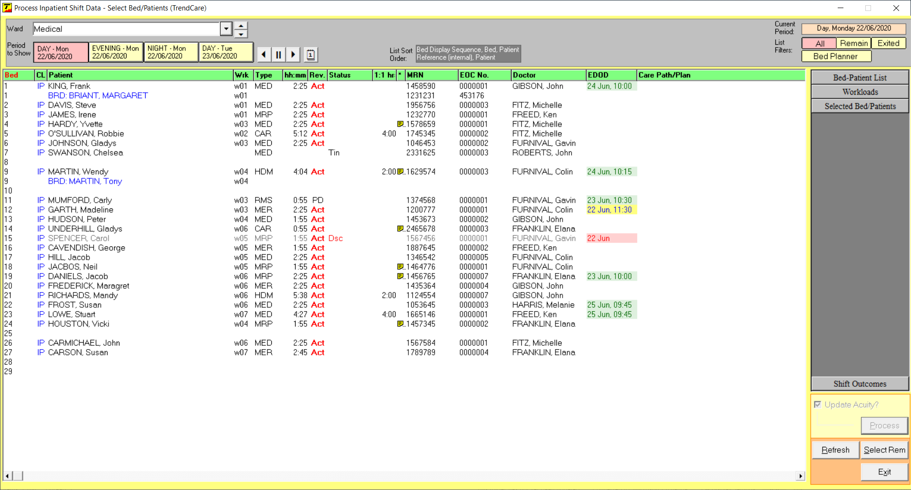
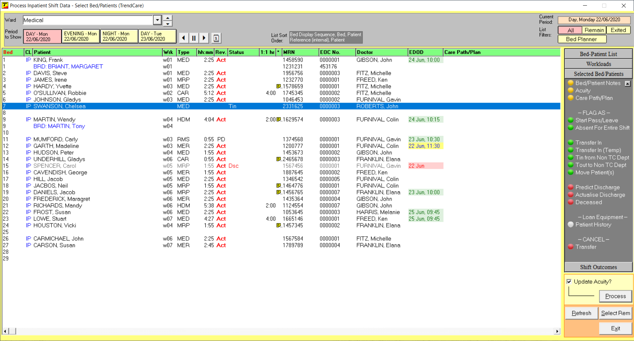
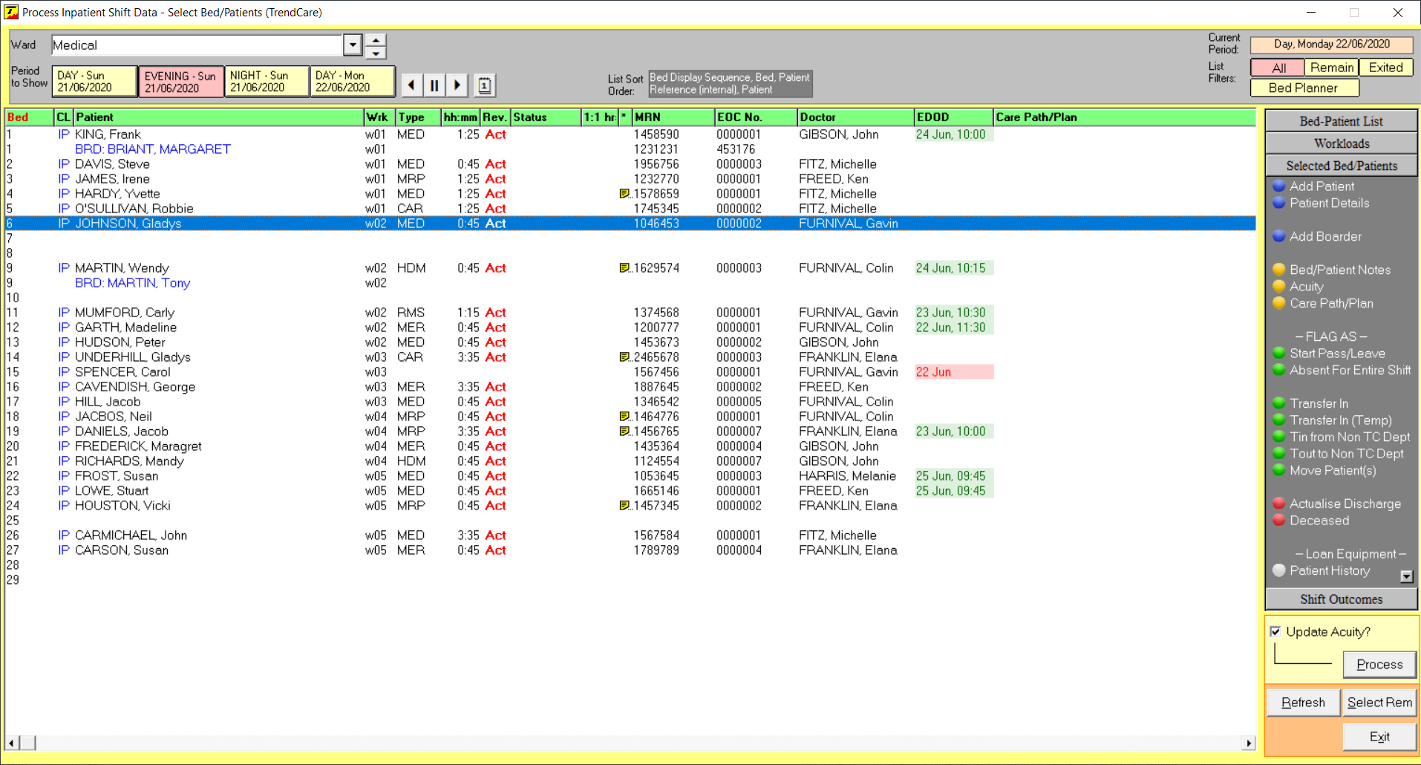
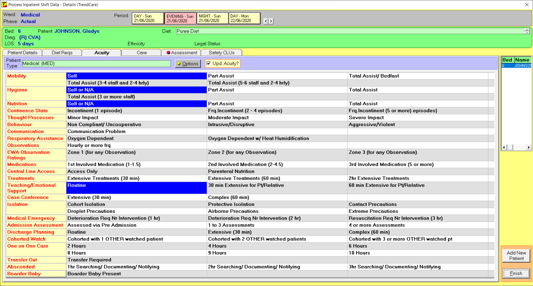
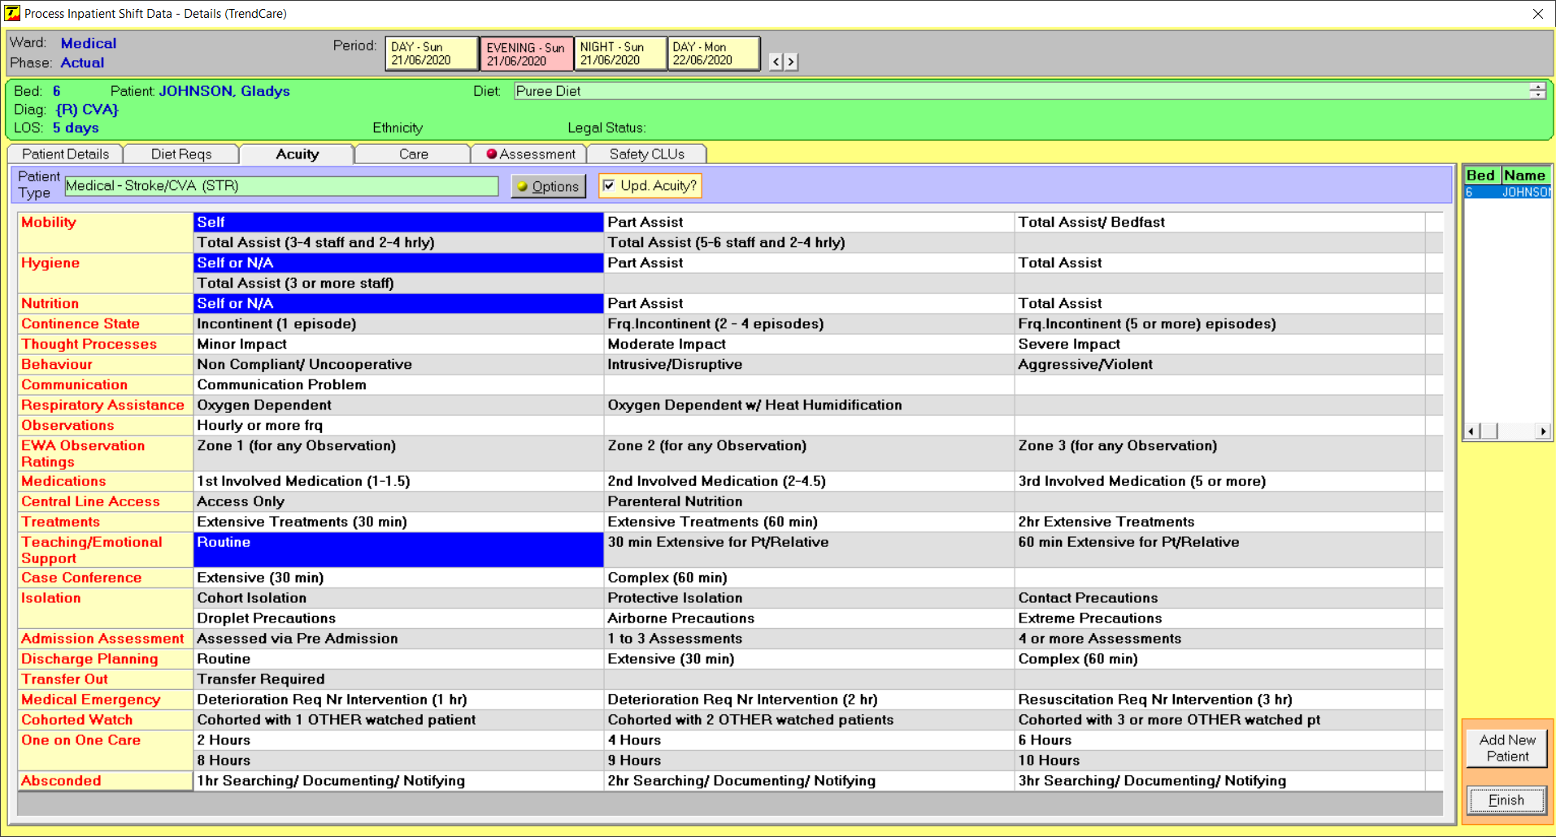
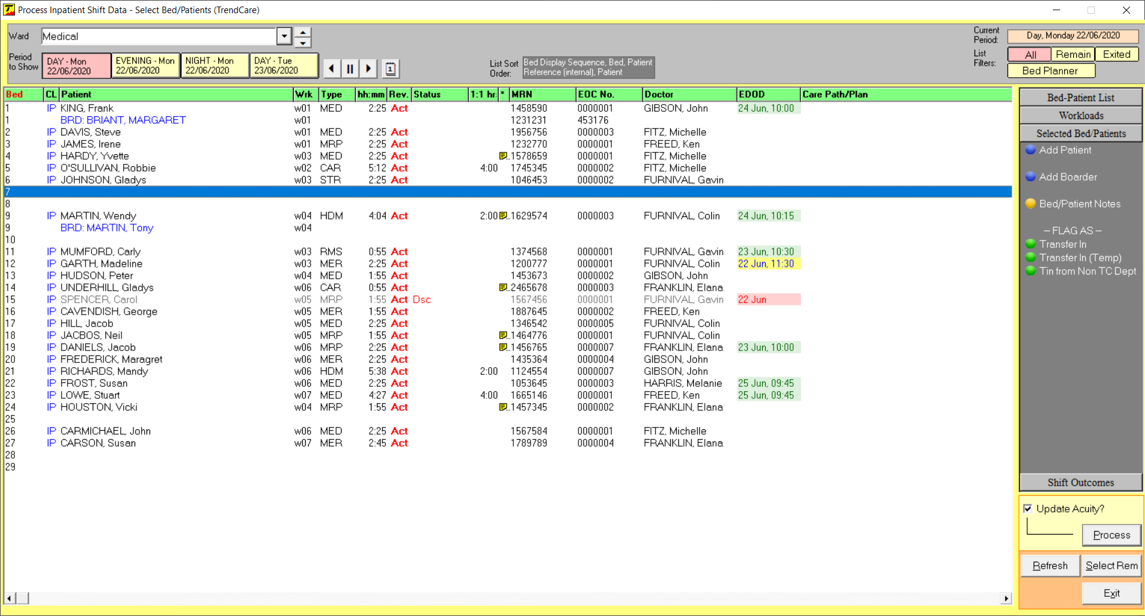
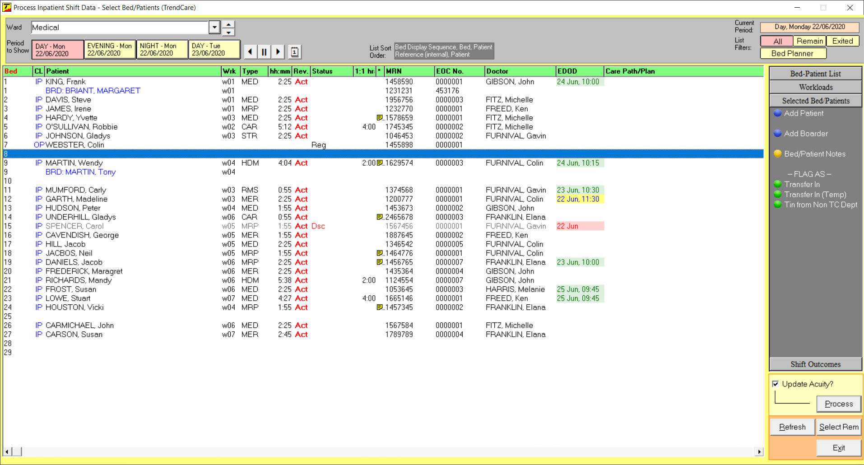
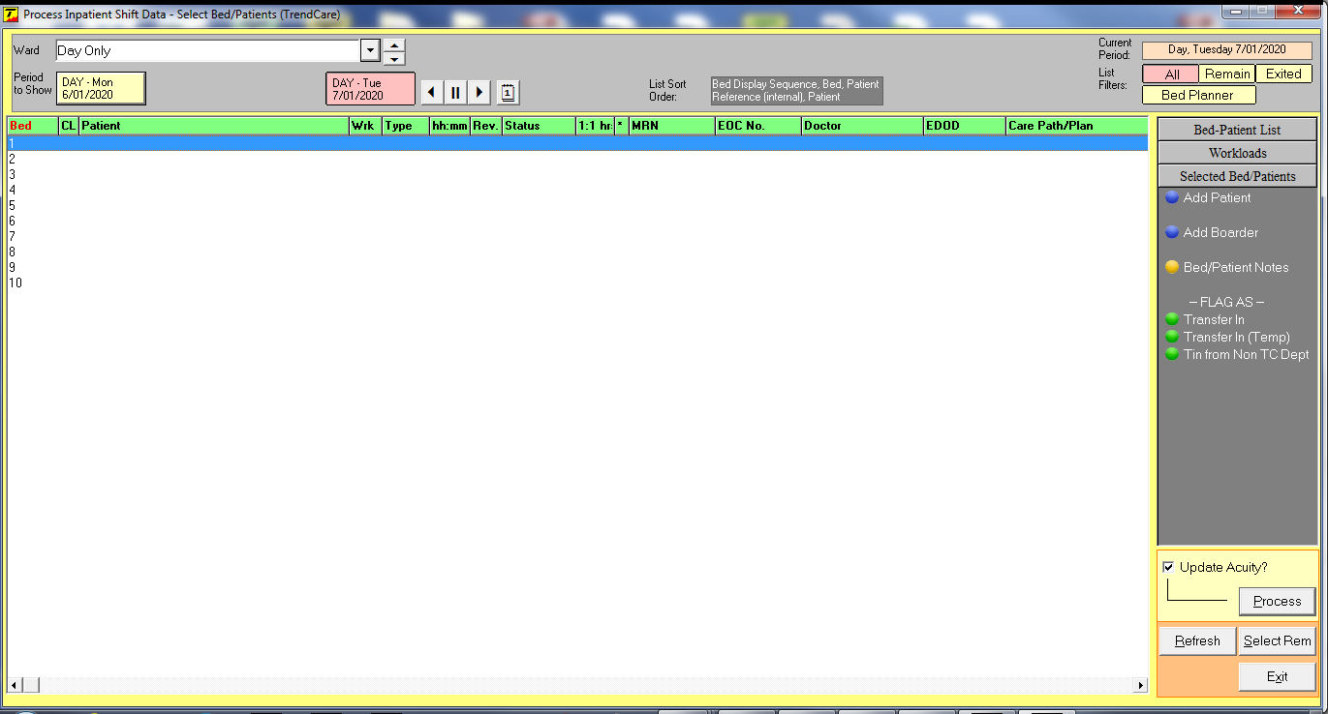
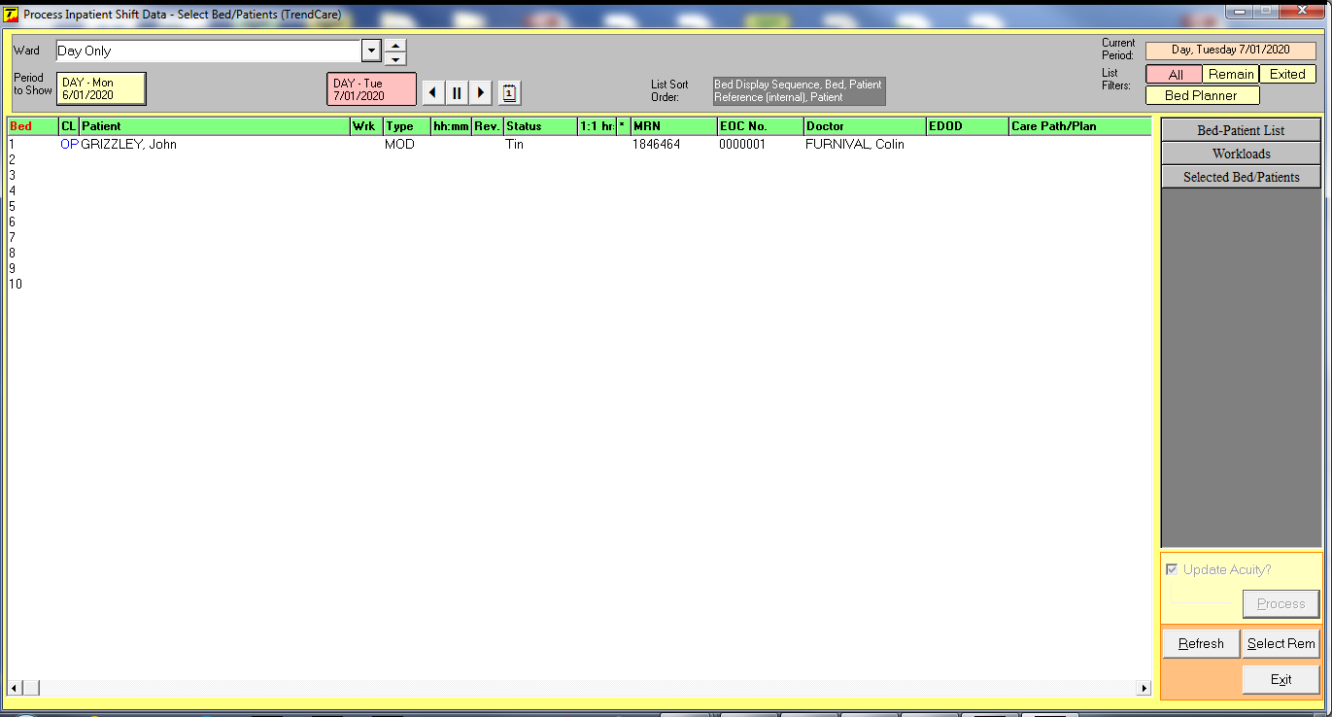
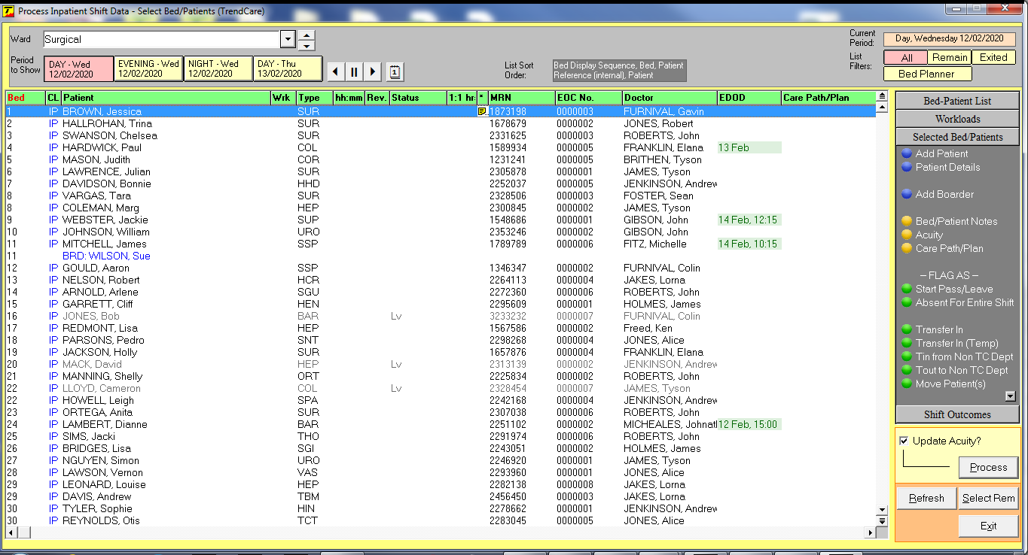
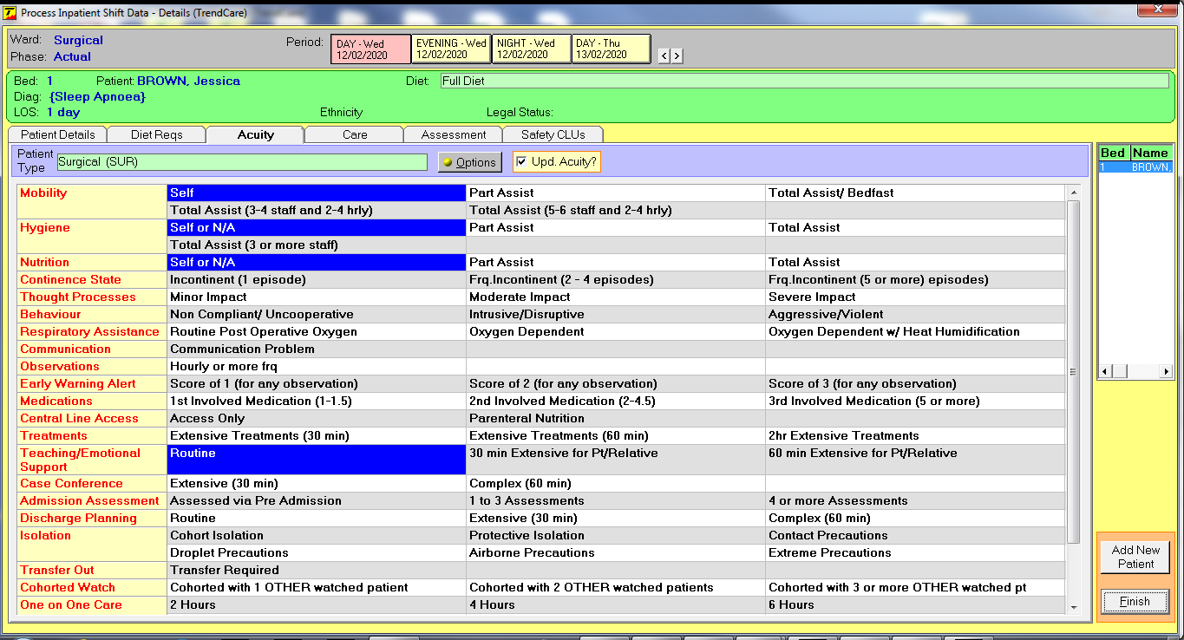
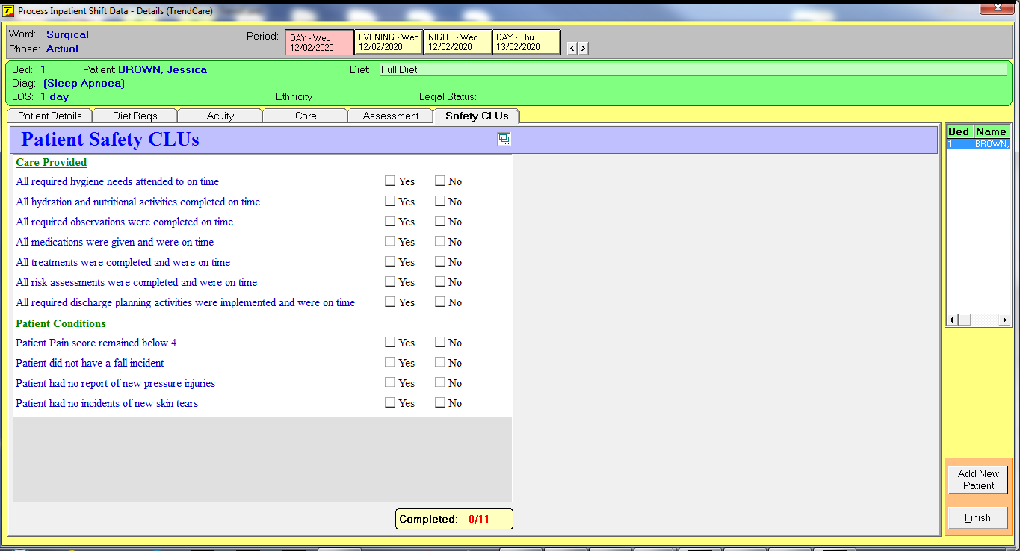
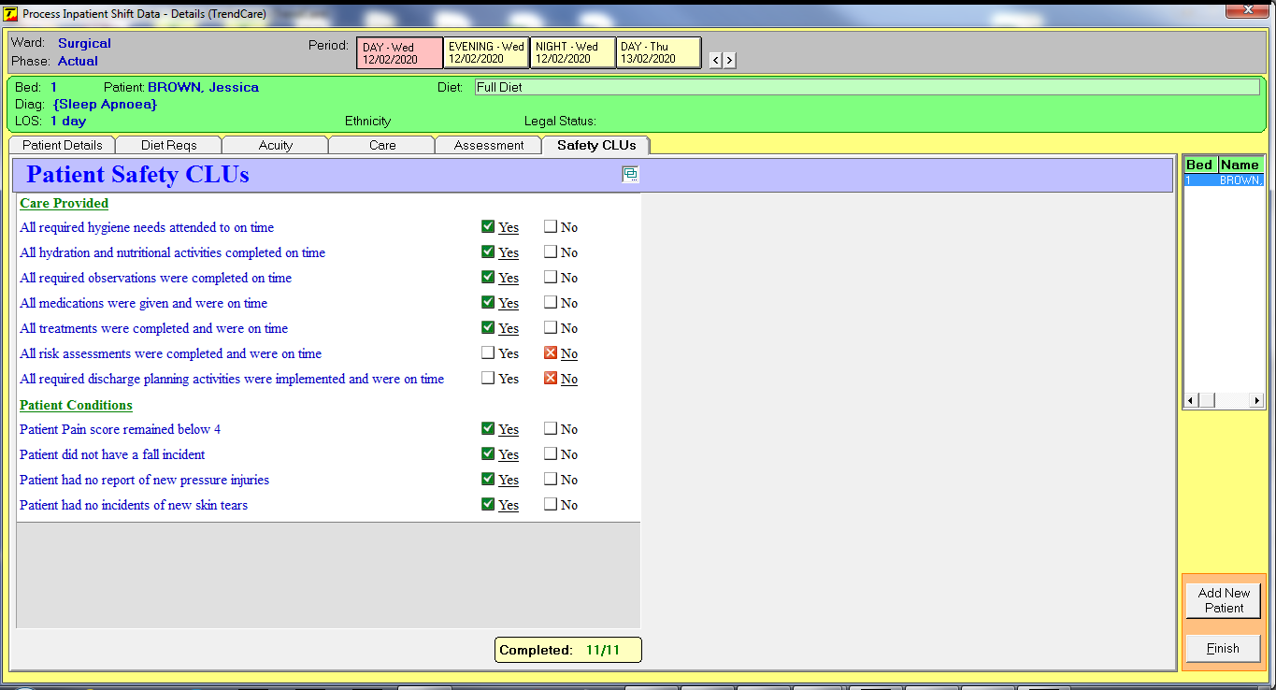
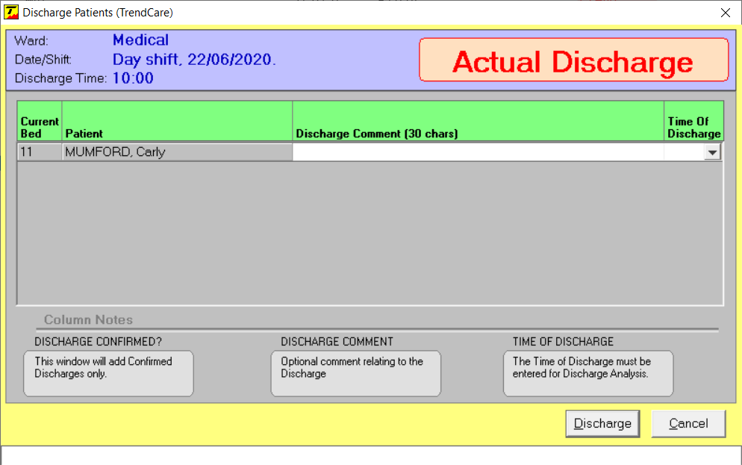
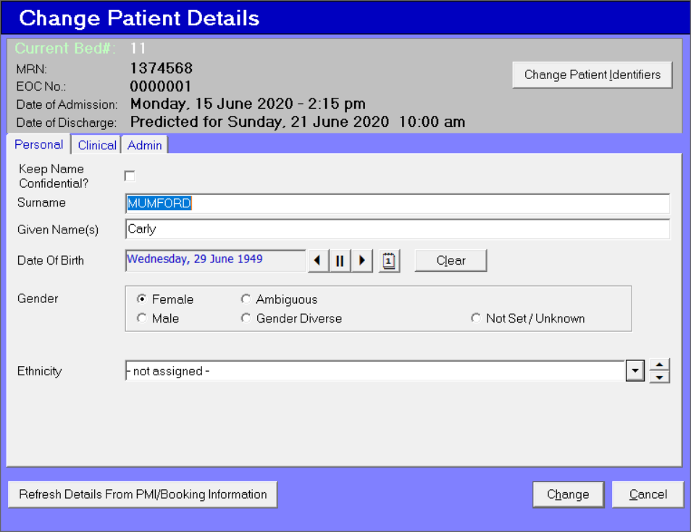
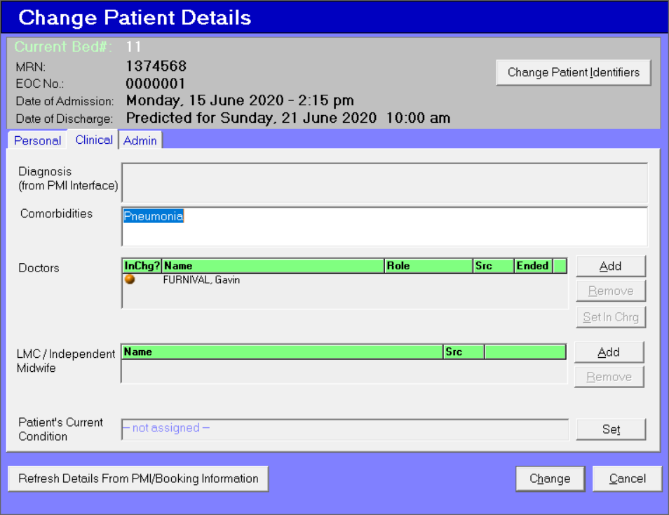
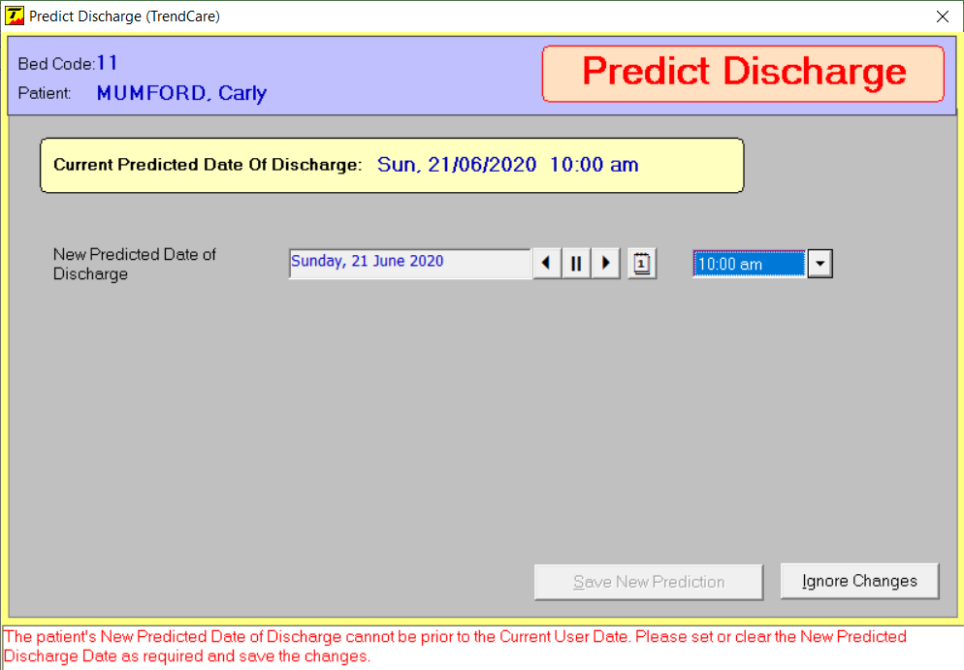
Inpatient Shift Data Screen
N.B. For a Registration the patient can be registered in multiple departments on different dates as required but only one registration may exist in any department for the Patient Number and EOC Number combination on a given shift
When the patient details shown are correct click: Continue
If the patient details shown are incorrect click: Cancel
References to ‘Shift’ have changed to: Period
To assist visibility of predicted discharges clicking EDOD will sort patients with an EDOD to top of the inpatient list
Discharge from previous shift button removed as part of EDOD redesign
A Patient Class based on HL7 standard definitions has been developed. These include;
OP Outpatient
IP Inpatient
EM Emergency
OB Obstetrics
CM Community
These are displayed on the Inpatient Shift Data screen in the CL column
The Patient class can also be added when manually adding a patient
Expected Date of Discharge (EDOD) is now highlighted amber if the predicted discharge is due on a previous shift. Note: The patient type is also removed from the patient
A prompt screen, to update or remove a prior shift EDOD, will appear when attempting to add acuity for patients whose discharge was predicted for a previous shift
Enter patient credentials and click Next
The patient transfer function has been enhanced to enable Day Only Units to predictively transfer in patients from the ward evening period before the evening begins
A new tab, "Safety CLUs“, has been created on the Process- Inpatient Shift Data Screen to enable users to complete Safety Care Left Undone questionnaires.
Patient has been transferred to the Day Only unit from the Evening shift- can be confirmed by clicking Tout status
Acuity screen (with previous Patient Type) becomes available once the predicted discharge date has been updated/removed
Confirm patient has been transferred from the Evening Period by selecting Medical Ward from the ward dropdown list
Gender Field: Now includes options to select, Ambiguous or Gender Diverse
Set a time and select a reason for Changing the Predicted Discharge Date
Nursing Shift Outcomes renamed to: Shift Outcomes
Patient is added with a patient class of OP (Outpatient) and a Status of Reg (Registration)
Once a discharge has been confirmed via a clinical pathway or an actualised discharge, the discharge date will be highlighted in red
Predicted discharges on the current date and shift are highlighted in yellow
Predicted discharges on future shifts/dates are highlighted in green
Updated EDOD and Patient Type reappears
A warning message is now displayed when patient types are changed retrospectively (prior to the current calendar date) to warn the user that all acuity hours will be cleared from that period onwards
Additional Notes field has been renamed: Comorbidities
When manually adding a patient, if you use credentials of an existing patient a pop up appears giving you the option to continue or cancel using those credentials
New Bed Planner button. This button removes the display of expected discharges for the current shift and from future shift inpatient screens to assist with bed and patient flow management e.g. current period is the day shift however we will view the evening period.
When Bed Planner is used the expected discharges for the current period (Day) are removed- potential empty beds are now shown.
When manually cancelling a Transfer in and choosing the option to Defer to next shift the user must provide a new Time of Transfer.
R) Click Workload, of a patient, to display name of staff member that patient is allocated to
When Time of T’Fer field is set to a time in the transfer from a wards’ evening period, only patients available to be transferred for the evening period will be shown in the list

Slide 5
Allocate - Patient Diets
References to ‘Shift’ have changed to: Period
References to ‘Dietician’ have changed to: Dietitian
Option: Remove Nutrition Indicator has been added to the Diet Order Form

Slide 6
Allocate Patient Conditions
References to ‘Shift’ have changed to: Period

Slide 7
Allied Health Register
Select Priority
A Not Completed Activities button has been added to the patient list screen to display all activities
not completed relevant to the group of patients visible in the list.
The ability to link interventions to a ward has been added to the patient contact screen
Select required Ward / Department
Comment tab is seen when Contact(s) tab is in use
The Gym Activities and Group Attendances tabs have been combined
Assess tab added to provide access to Patient Assessments
Activities performed are associated to the ward selected
when creating the contact
Patient tab added to provide access to; Details, Priority Rating and Discharge functions
Assessment screen opens: Select and process patient assessment in usual manner
Consumables used are associated to the ward selected
when creating the contact
The number of Gym Activities and Group Attendances sessions able to be selected has increased to 15

Slide 8
Roster Maintenance and Development
Changes to colours in Roster Development:
Breaches appear as red font on a yellow highlight
Absenteeism codes appear as black font on an orange highlight
Changes to Multiward roster:
When roster codes are being entered for the selected ward, they are displayed as black font on white background, while roster Codes, for other the wards/departments in a multi-ward roster, are now shown in italics and shaded blue.
Also in review Shift Details is a ‘Code Details’ button which can be used to display all details of the roster code.
This option is also available when using the ‘swap shifts’ function
Notes referring to Julie King from the Roster Unit Template, as shown previously, are not available
For each tab in the Roster Unit Template, the Totals row has been added to the corresponding report
Roster Unit Template has been changed to accommodate 31 days rather than 28 for Roster Units when using the 1 Calendar Month option.
The number of Part Day Leave hours are now shown in Shift Details- (R) Click code
Roster Unit Template view is now 37 days which accommodates the ‘rolling start day’ when using the 1 Calendar Month option
Part Day Leave Hours can be selected in 15-minute increments
Roster Unit Template Notes now display automatically when the template is opened.
There is the option to see these notes only on the template or also to populate Notes in Roster Development
By checking ‘Template Only Note’, the note will not populate Roster Notes when creating a new Roster Period

Slide 9
New Reports

Slide 10
Enhanced Reports
Allied Health and Specialist Nurse/Midwife Reports
The following reports have been enhanced to display up to 300 Clinicians;
Allied Health Clinician Activity Times
Allied Health Clinician Consumables
Allied Health Clinician Interventions Consumables Summary
Allied Health Clinician Interventions
Specialist Nurse / Midwife Clinician Activity Times
Specialist Nurse / Midwife Clinician Consumables
Specialist Nurse / Midwife Clinician Interventions Consumables Summary
Specialist Nurse / Midwife Clinician Interventions
Miscellaneous Reports
Hospital and Ward/Department Staff Performance Review Report
The performance review achievement score has been added to the performance review reports, this will only occur if performance scores have been added into HRM maintenance and a performance score is allocated at a time of review.
Business Unit and Ward/Department Period Casual Hours Report
Day and shift filters have been added to the Hospital, Business Unit and Ward / Department Period Casual Hours report selection screen.
Posted Roster vs Current Roster
The report previously named 'Print Roster Posted Vs Rostered' has been changed to 'Posted Roster vs Current Roster' The help file and report example have been updated.
Allied Health/Specialist Nurse Ward and Business Unit Reports
Allied Health / Specialist Nurse Ward and Business Unit Reports will now only display the activities entered for the Ward / Business Unit selected in the Reports selection screen.
Hospital Staff Clinical Specialty Privilege Report
Option added to select either status of: Approved or Withdrawn
Patient Episode Reports
The following patient episode reports have had the patients LOS added;
Patient Assessment History
Patient Episode - Assessment Action Plan
Patient Episode - Staffing
Patient Episode - Acuity Detail
Patient Episode - Acuity
Patient Episode - Clinical Hours
Patient Episode - Shift Notes
Patient Episode - Allied Health Intervention History
Patient Episode - Allied Health Intervention Summary
Patient Episode - Allied Health Clinician Interventions
Patient Episode - Allied Health Consumable History
Patient Episode - Allied Health Consumable Summary
Patient Episode - Allied Health Clinician Consumables
Patient Episode - A.H. Interventions/Consumables Summary
Patient Episode - SN / MW Intervention History
Patient Episode - SN / MW Intervention Summary
Patient Episode - SN / MW Clinician Interventions
Patient Episode - SN / MW Consumable History
Patient Episode - SN / MW Consumable Summary
Patient Episode - SN / MW Clinician Consumables
Patient Episode - SN / MW Interventions/Consumables Summ.
Staff Reports
Staff Reports have been extended to display a maximum of 500 staff members in one report. These reports include;
Staff Clinical Privileges
Staff Details
Staff Development Profile
Staff Health Profile
Staff History Summary
Staff History
Staff Home Ward History
Staff HRM Presenter Session Summary
Staff Performance Review History
Staff Period Allocated Patients
Staff Period Allocated Workloads
Staff Period Leave
Staff Period Profile Plus Summary
Staff Period Profile
Staff Period TOIL
Staff Period Work Area
Staff Position History
Staff Profile
Staff Role History
Staff Rostered Shifts

Slide 11
New Lists/Forms

Slide 12
Maintain Hospitals
Option to deactivate patient and episode number fields for boarders
A "1 Day" option has been added to the list of "Maximum Age of Assessments to Copy?" setting.
An Address for each hospital can now be added if required to interface with other systems.

Slide 13
Maintain - General
Enhancements
Doctor
When a new record is created or an existing record is amended, the front list now displays the Surname then the Given Name regardless of the country set in the System.
Health Activities
Health activity extended description has been extended to 225 characters. This has also been extended in gym activities and group attendances.
Shift Outcomes
Nursing Shift Outcomes renamed Shift Outcomes. This will enable other disciplines to use the Shift Outcomes Questionnaire.
All Shift Outcome questions are now able to be customised in maintenance. The True/False responses have been changed to Yes/No
Loan Equipment
A reason can now be allocated when removing a piece of equipment from the equipment list
Reason for One on One Care / Cohorted Watch
Reason for One on One Care and List Reason for One on One Care have been renamed:
Reason for One on One Care / Cohorted Watch and List Reason for One on One Care / Cohorted Watch.
List Types of Causes of Variance
Spelling errors corrected.
Awaiting Aged Home Placement is now: Awaiting Residential Care

Slide 14
Maintain Staff
New Staff Titles
Assistant Director Midwifery
Call Centre Operator
Deputy Director Midwifery
Director Midwifery
Driver
Housekeeper
Human Resource Officer
Interpreter
Marketing Officer
Quality Officer
Purchasing Officer
Radiology Assistant
Safety Officer
Senior Manager
Senior Midwife Clinician
Supply Officer
Switch Operator
Training and Development Officer
Each Staff Contract now has the ability to add an Organisation Number to a staff contract. When added to a staff contract the organisation number is visible in the following screens; Allocate Staff, Enquiry Allocate Staff, Enquiry Roster, Process Roster, Maintain Roster, Reporting.
Travel distance now displays in Miles when System Properties is set to UK
Visa Details tab added- enables staff Visa to be added in Maintain Staff as well as via the HRM Visa Register

Slide 15
System
SYSTEM PROPERTIES
New Feature
Exports and Reports
Each site can now nominate the default path for saving Exports and Reports. Found in System properties – general tab.
Enhancements
Country/Sate
If the system is set to use Thailand as the, 'Country/State', then names are displayed as Given Names [space] SURNAME. Note: Sorting will also change to prioritise Given Names first.
WORKSTATION/SESSION PROPERTIES
The field name, Description has been changed to: Closest Phone Extension

Slide 16
Questions?

